Slide 1










SasView
Data Analysis for Small Angle Scattering

Slide 2





A little history …
2006
Heritage: NIST IGOR macros
SansView is DANSE project output
~ 8.5% of funds were for SANS
2011
2012
NIST Supported initial transition from NSF funding
2013
Transition to Community project.
1st Code Camp at NIST April 2013
2014
2nd Code Camp at ISIS April 2014
2015
Move to GitHub
v3.0 released
3rd Code Camp at ESS Feb 2015
Rename to SasView
v3.1 released
2016
4th Code Camp at TU Delft March 2016
v4.0 released
5th Code Camp at ORNL Oct 2016
2017
v4.1 released
6th Code Camp at ILL/ESRF April 2017
7th Code Camp at DMSC October 2017
2018
v4.2 released
8th Code Camp at ESS Sept 2018
v5.0b1 released
1st SasView User Meeting at SAS2018
2019
v4.2.1 released
9th Code Camp at ILL/ESRF March 2019
v5.0b2 released

Slide 3
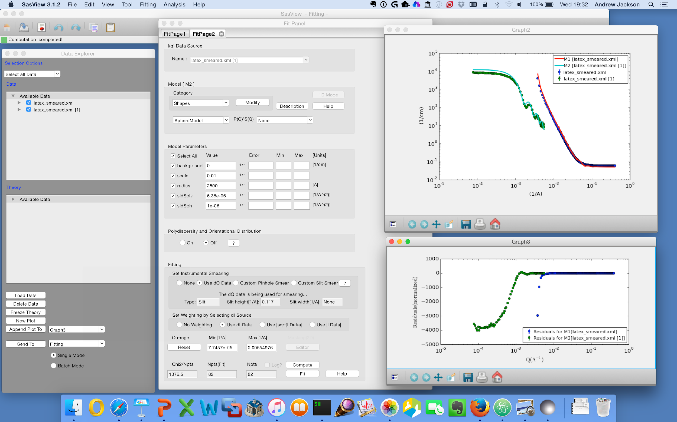
1D Analysis
Data management
Common data formats supported, including NXCansas & cansas1D
Wide choice of built-in models (> 70)
P(Q), S(Q) & P(Q)*S(Q)
Simultaneous fitting
Analysis Tool Choice
&
Plotting
Generic parameter polydispersity
Choice of distribution and distribution parameters
Resolution smearing (pinhole and slit)
Automatically from data or provide parameters

Slide 4
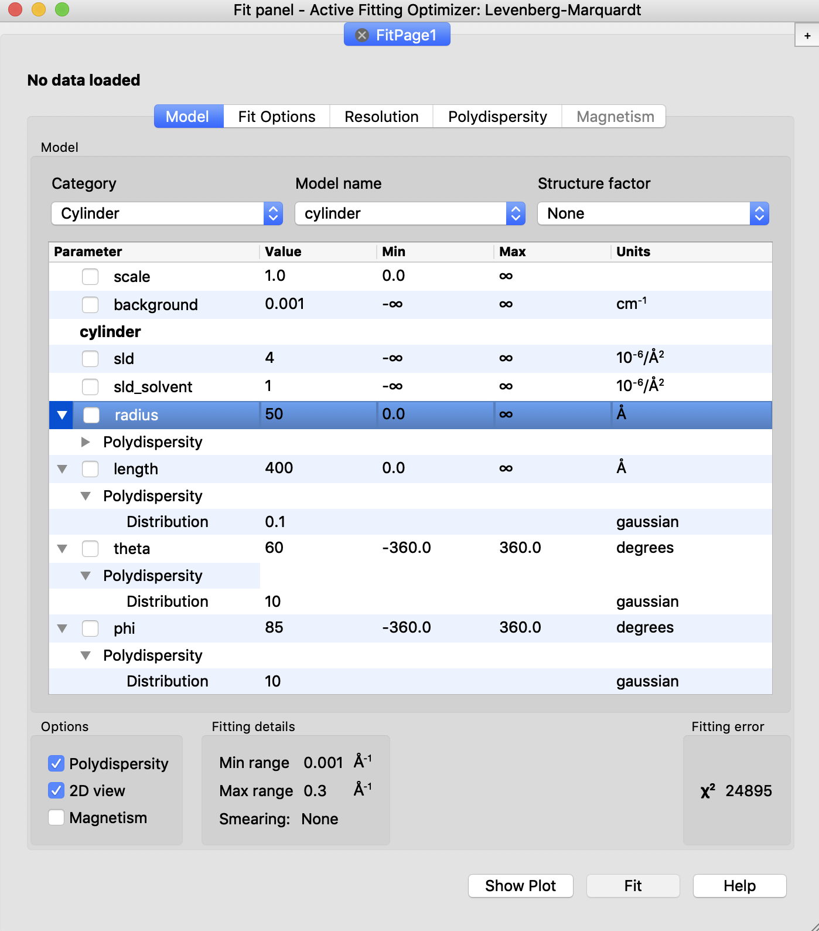
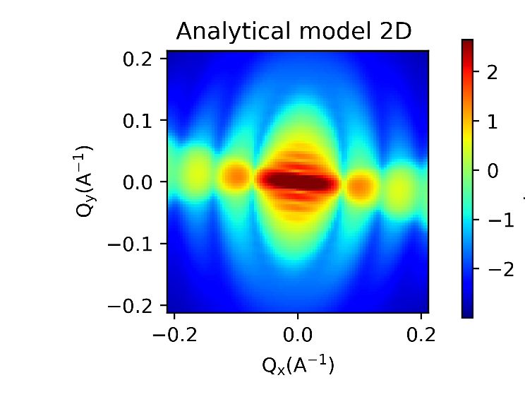
2D Analysis

Slide 5
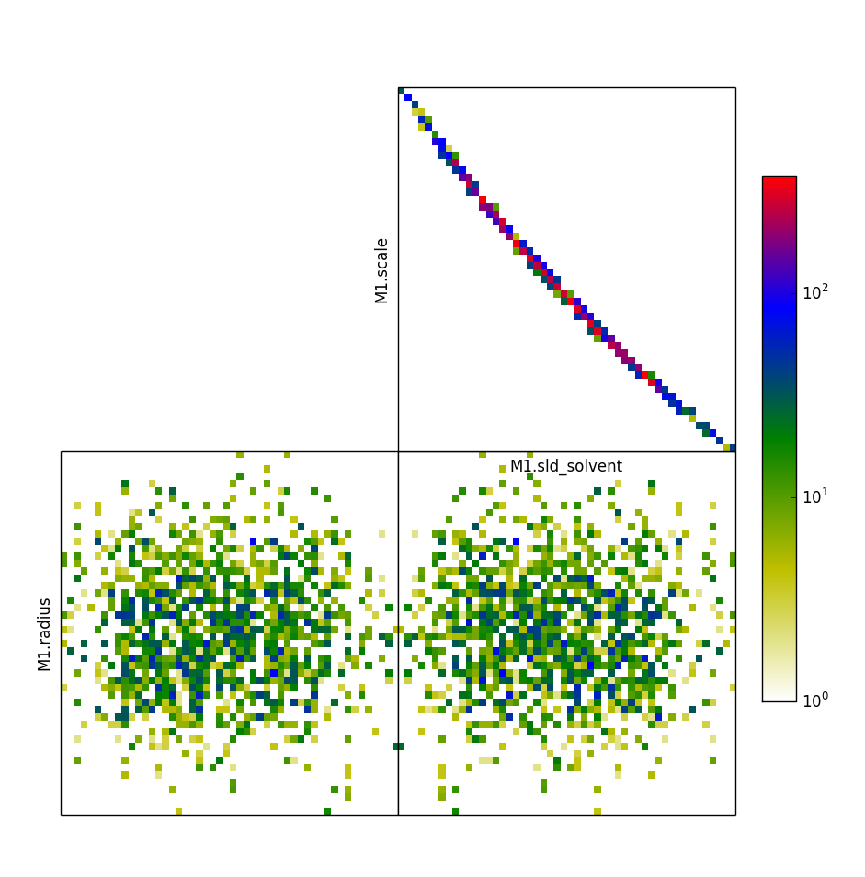
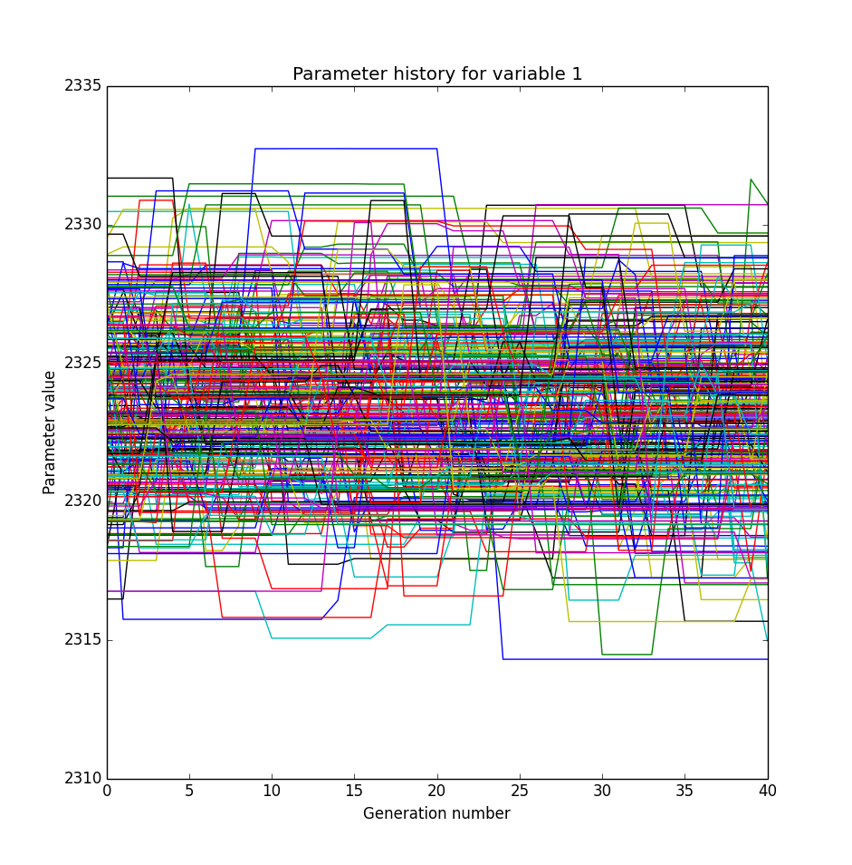
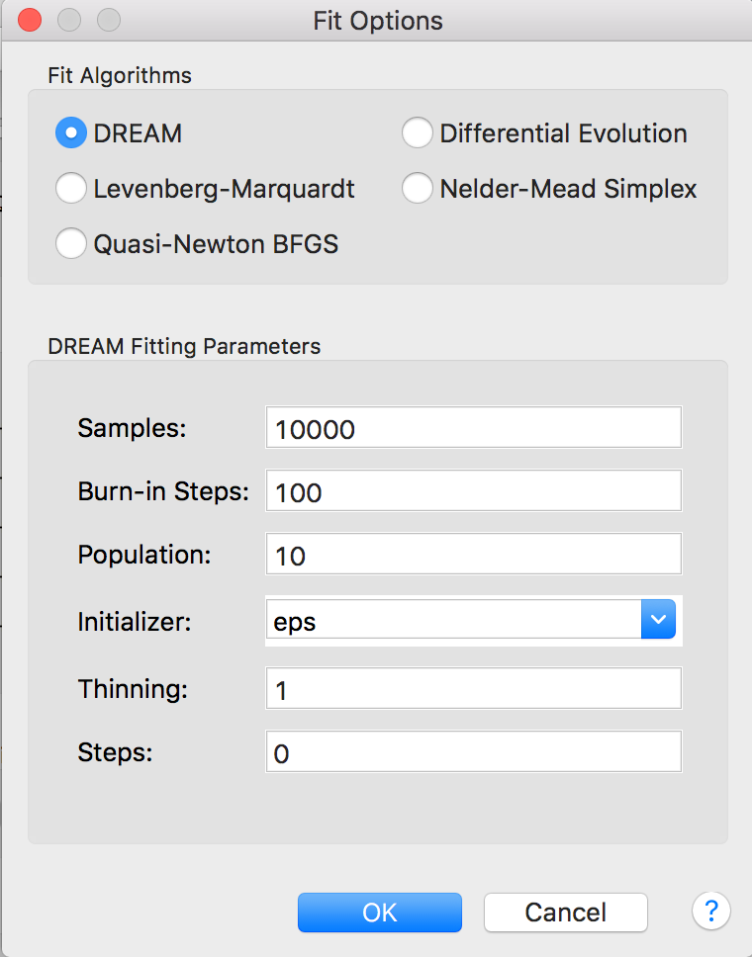
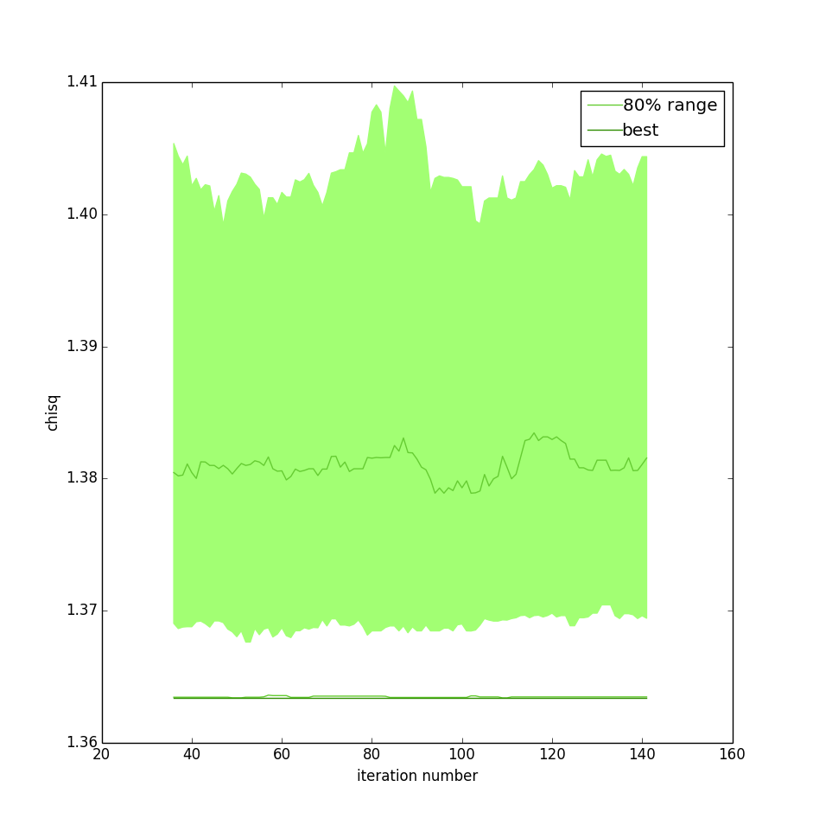
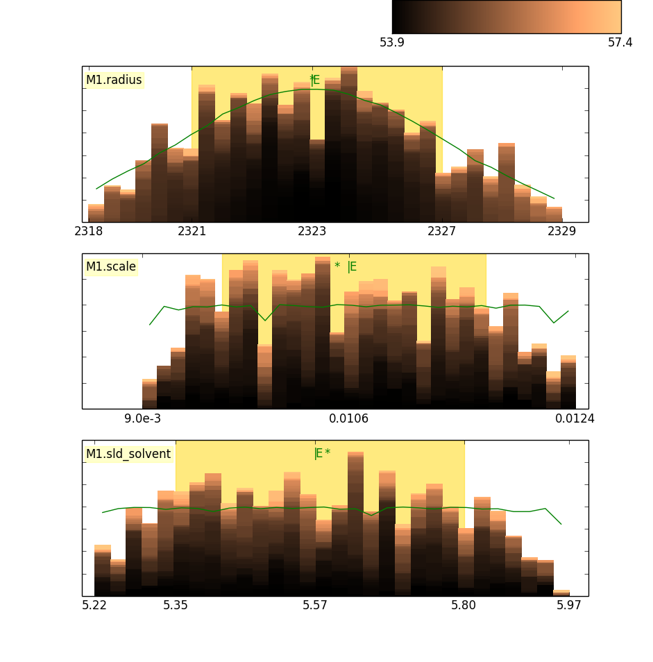
Fitting Algorithms
Uses bumps package from P. Kienzle

Slide 6
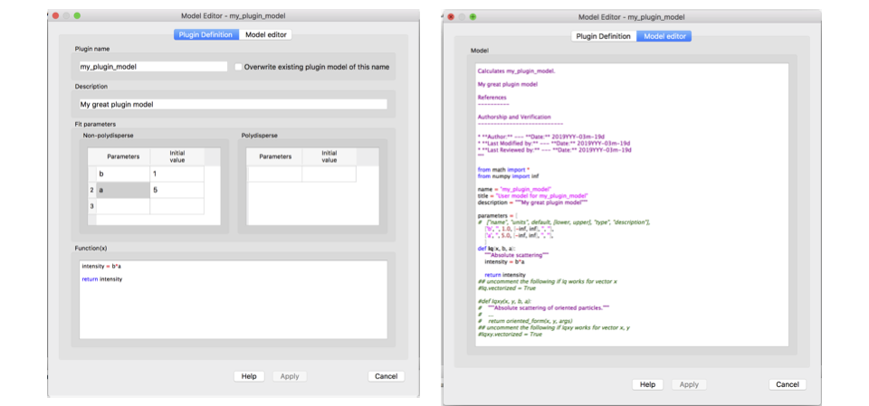
Plugin Model Editor

Slide 7
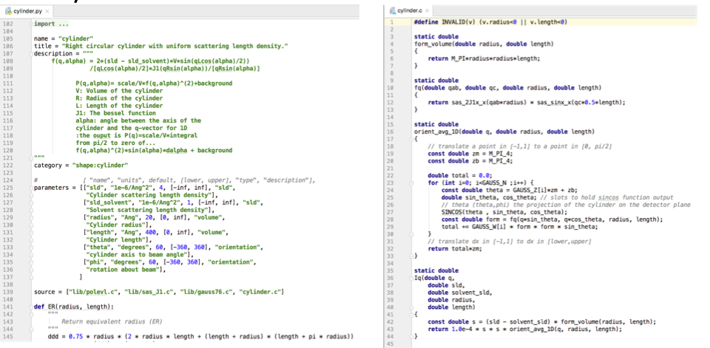
Python & C model files

Slide 8
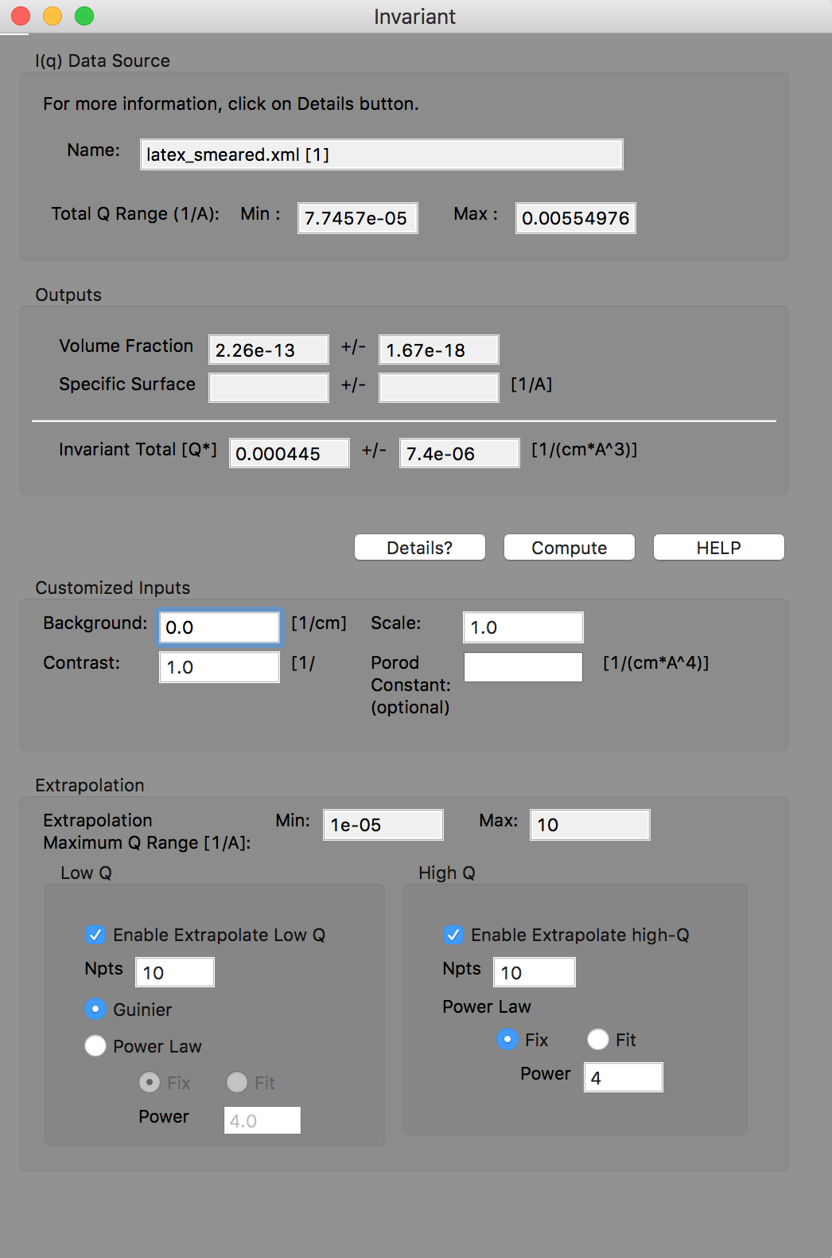
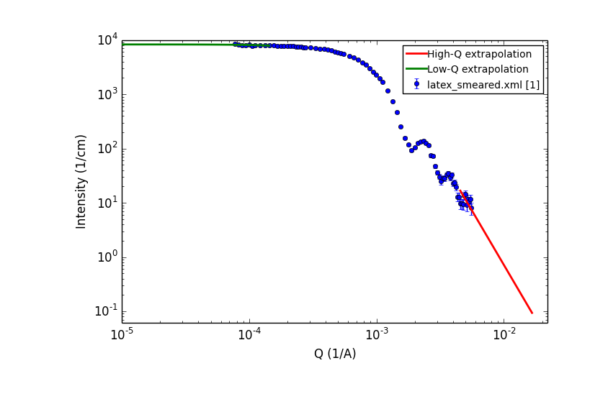
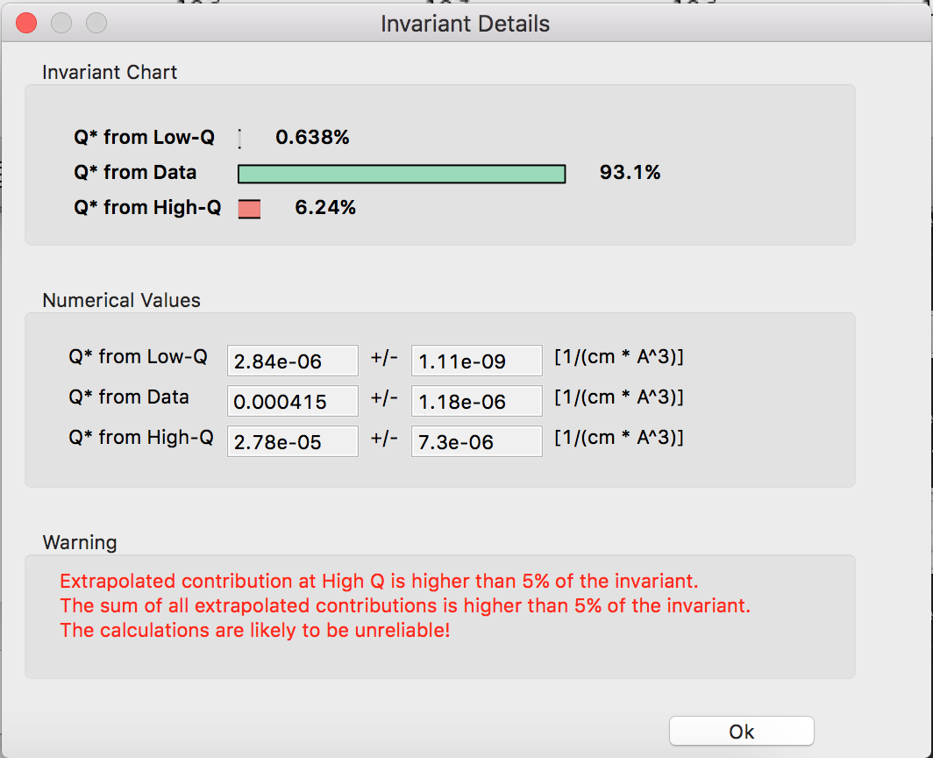
Invariant Calculation

Slide 9
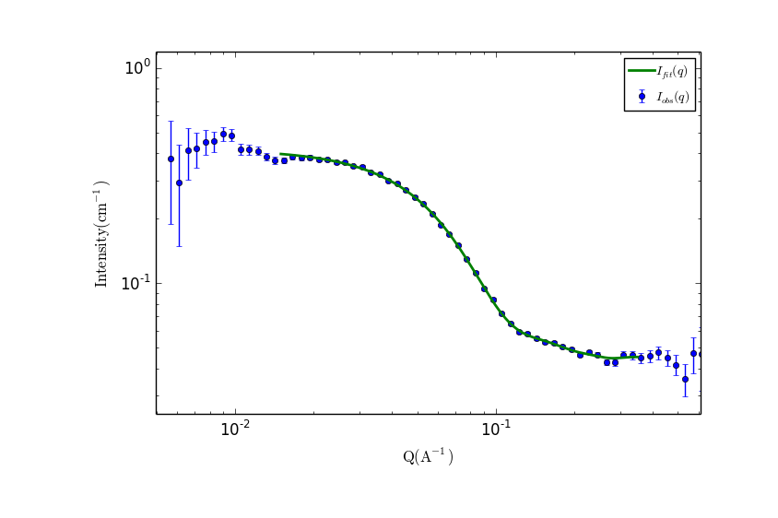
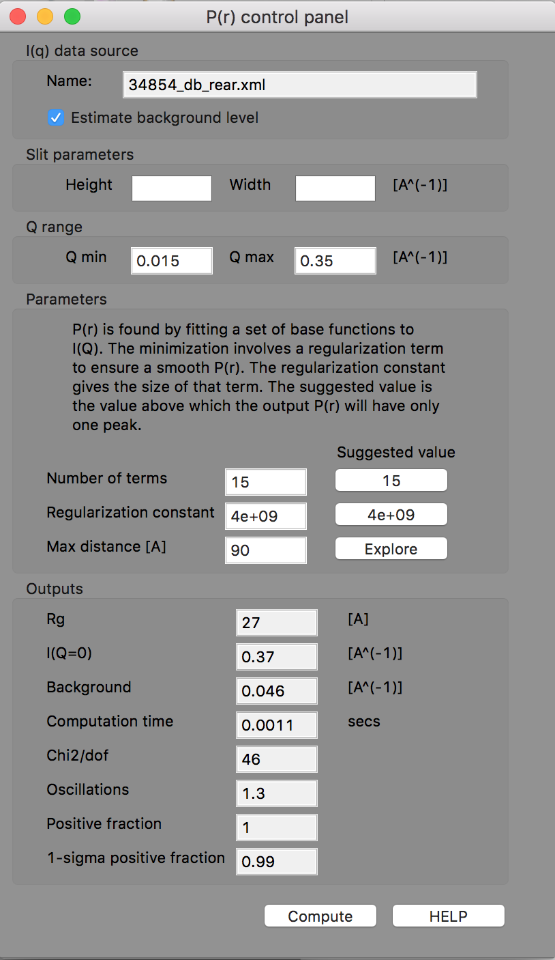
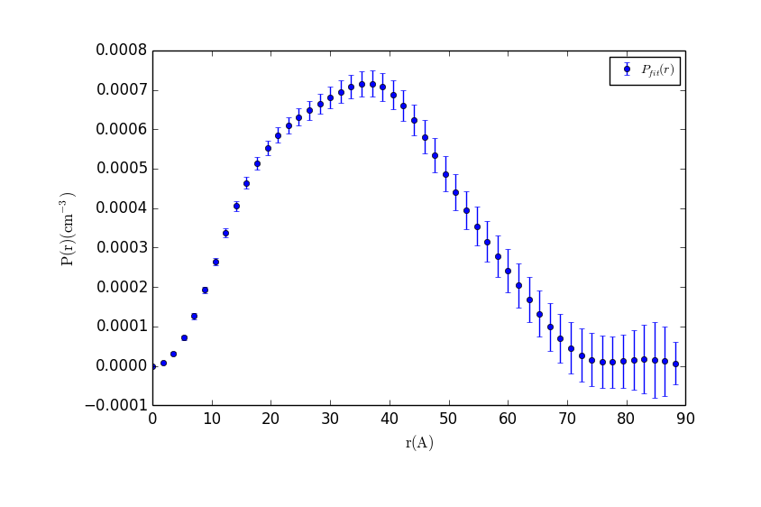
P(r) Inversion

Slide 10
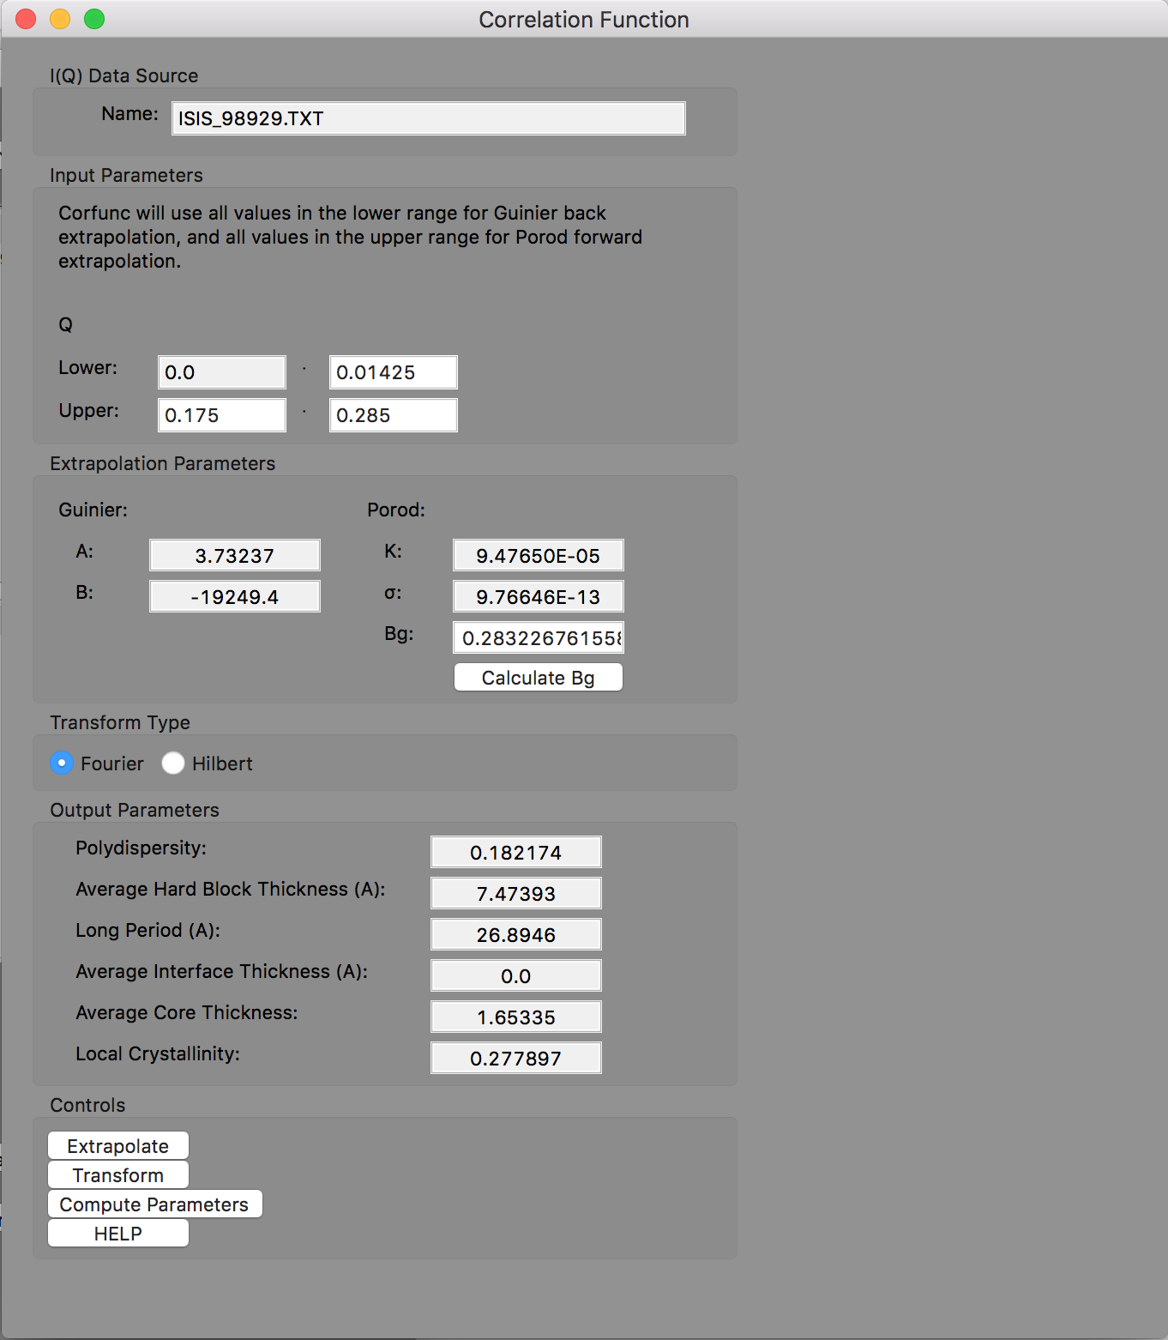
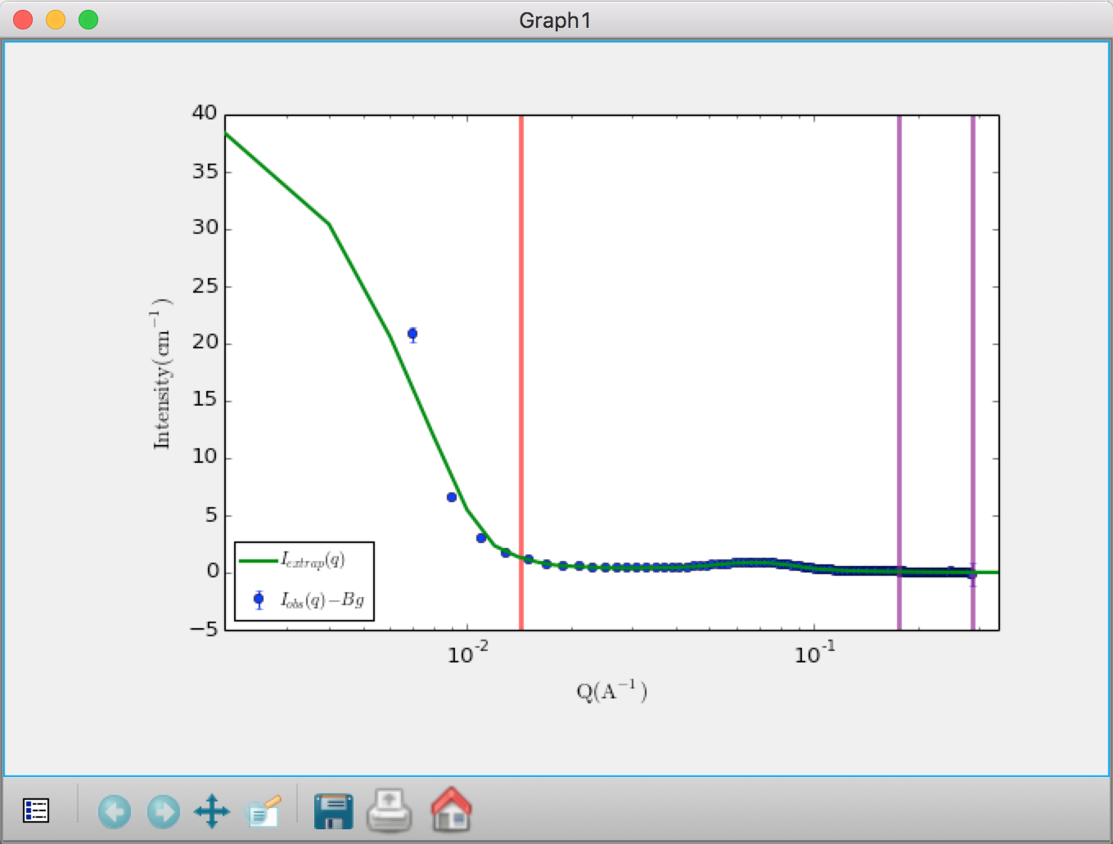
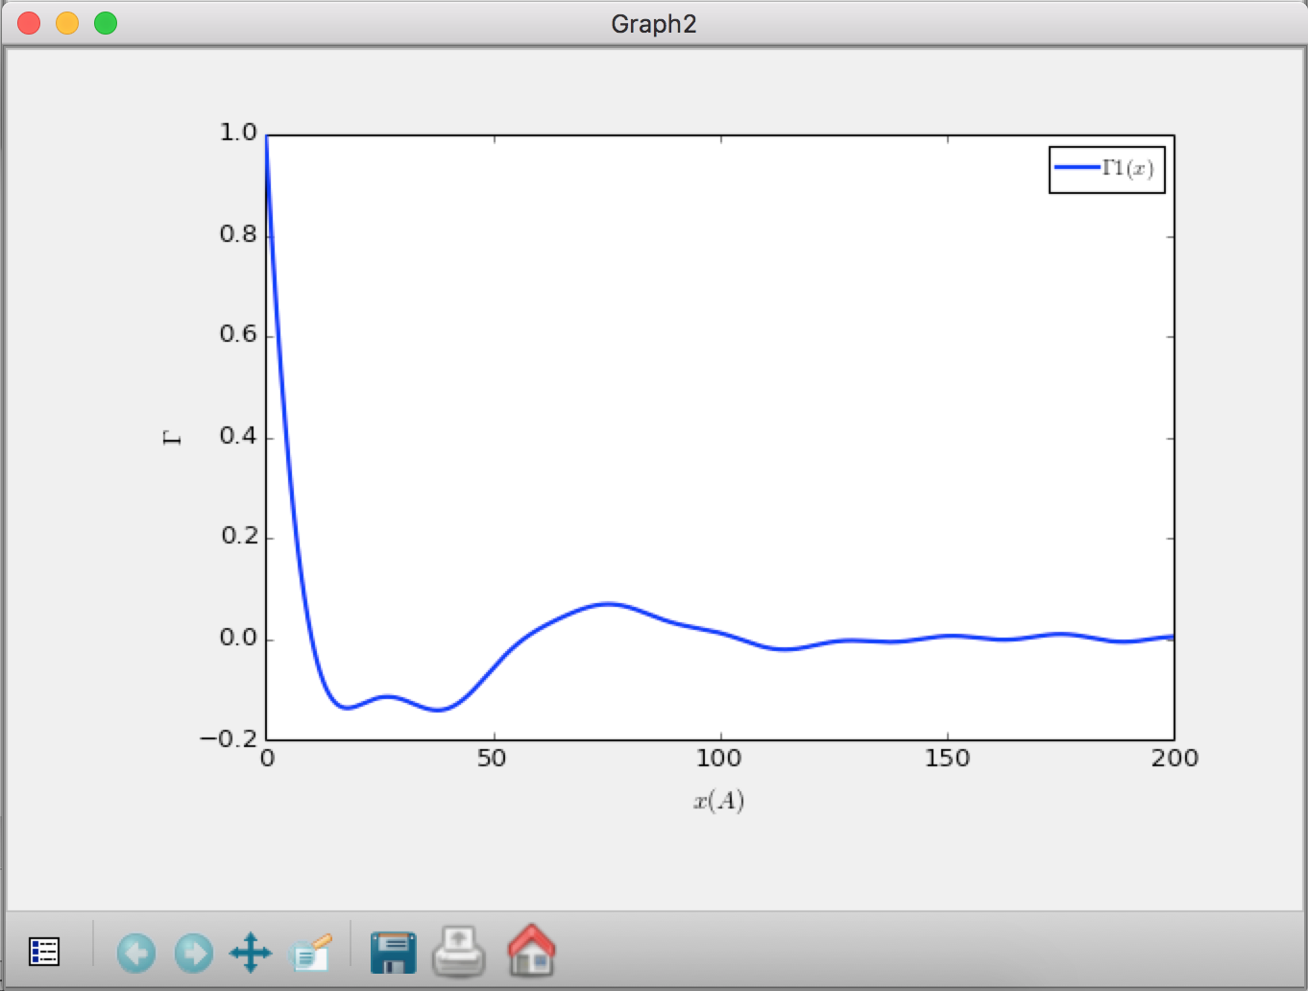
Correlation Function Analysis (new!)

Slide 11
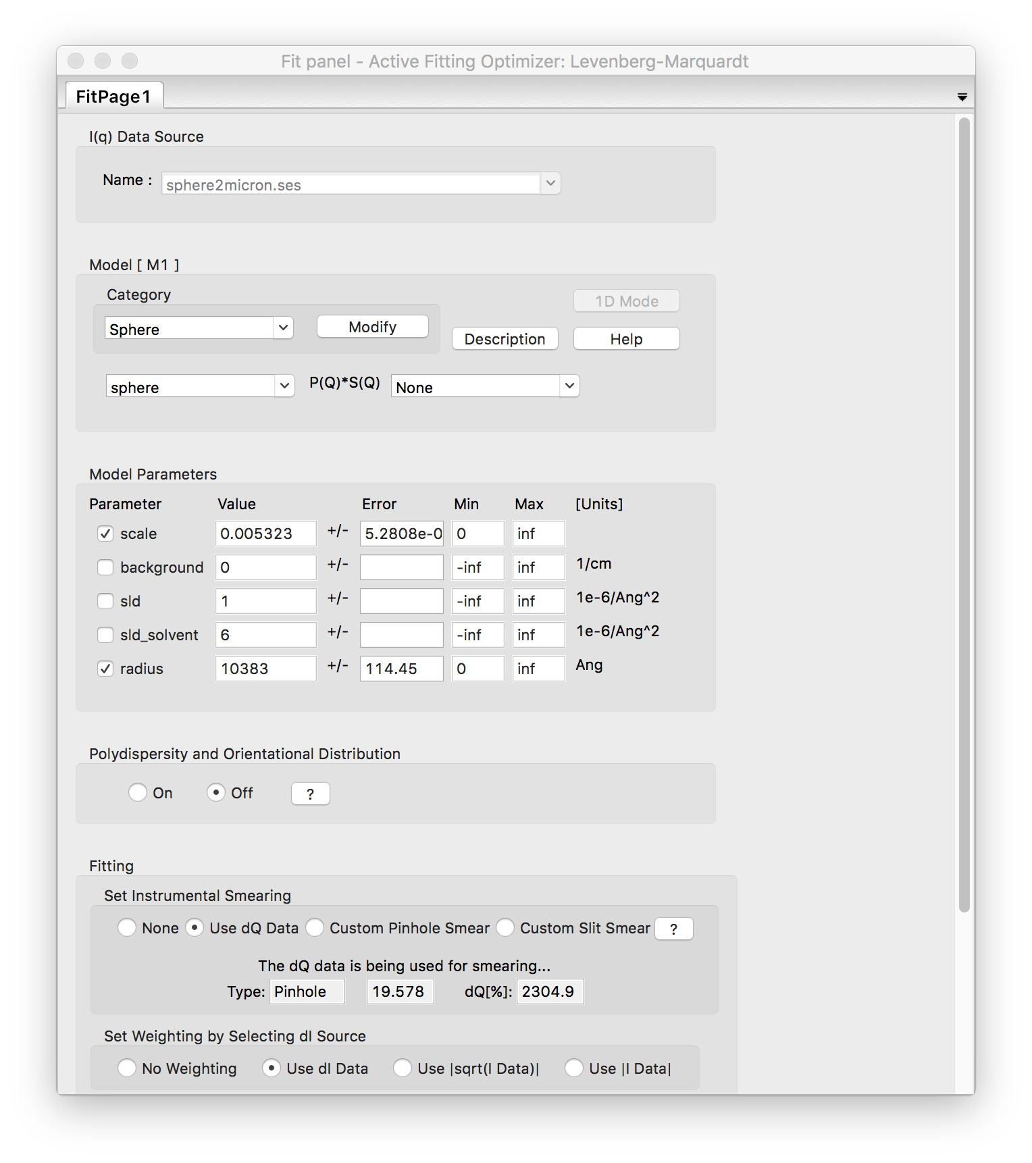
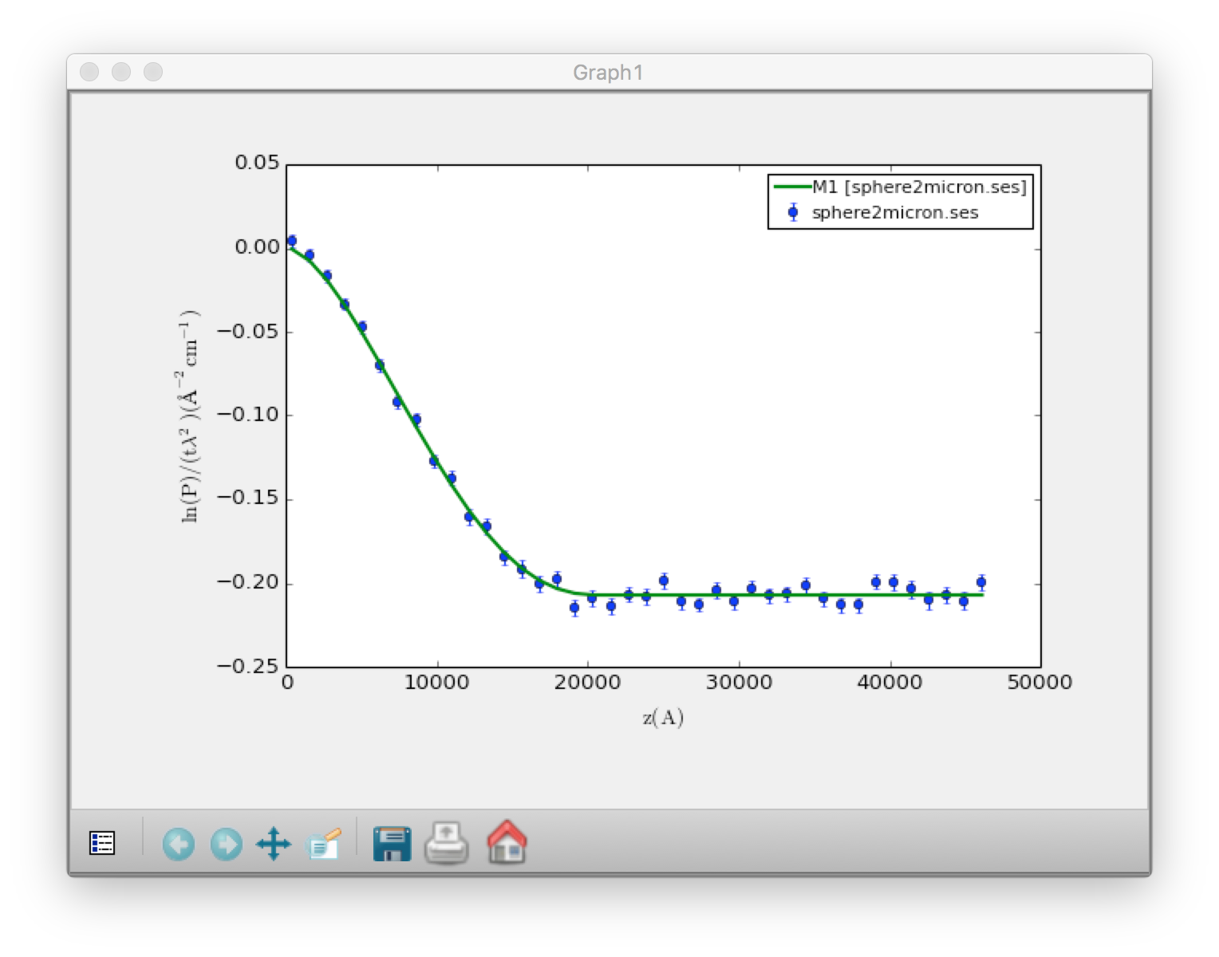
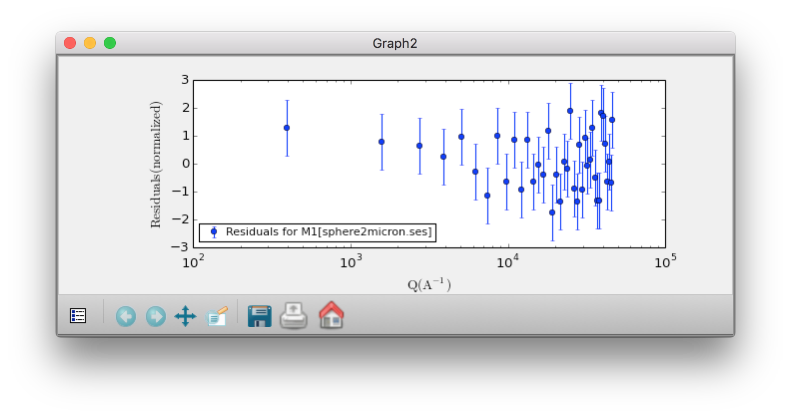
SESANS Analysis
Automatic Hankel Transform of SANS models
(TU Delft & ISIS)

Slide 12
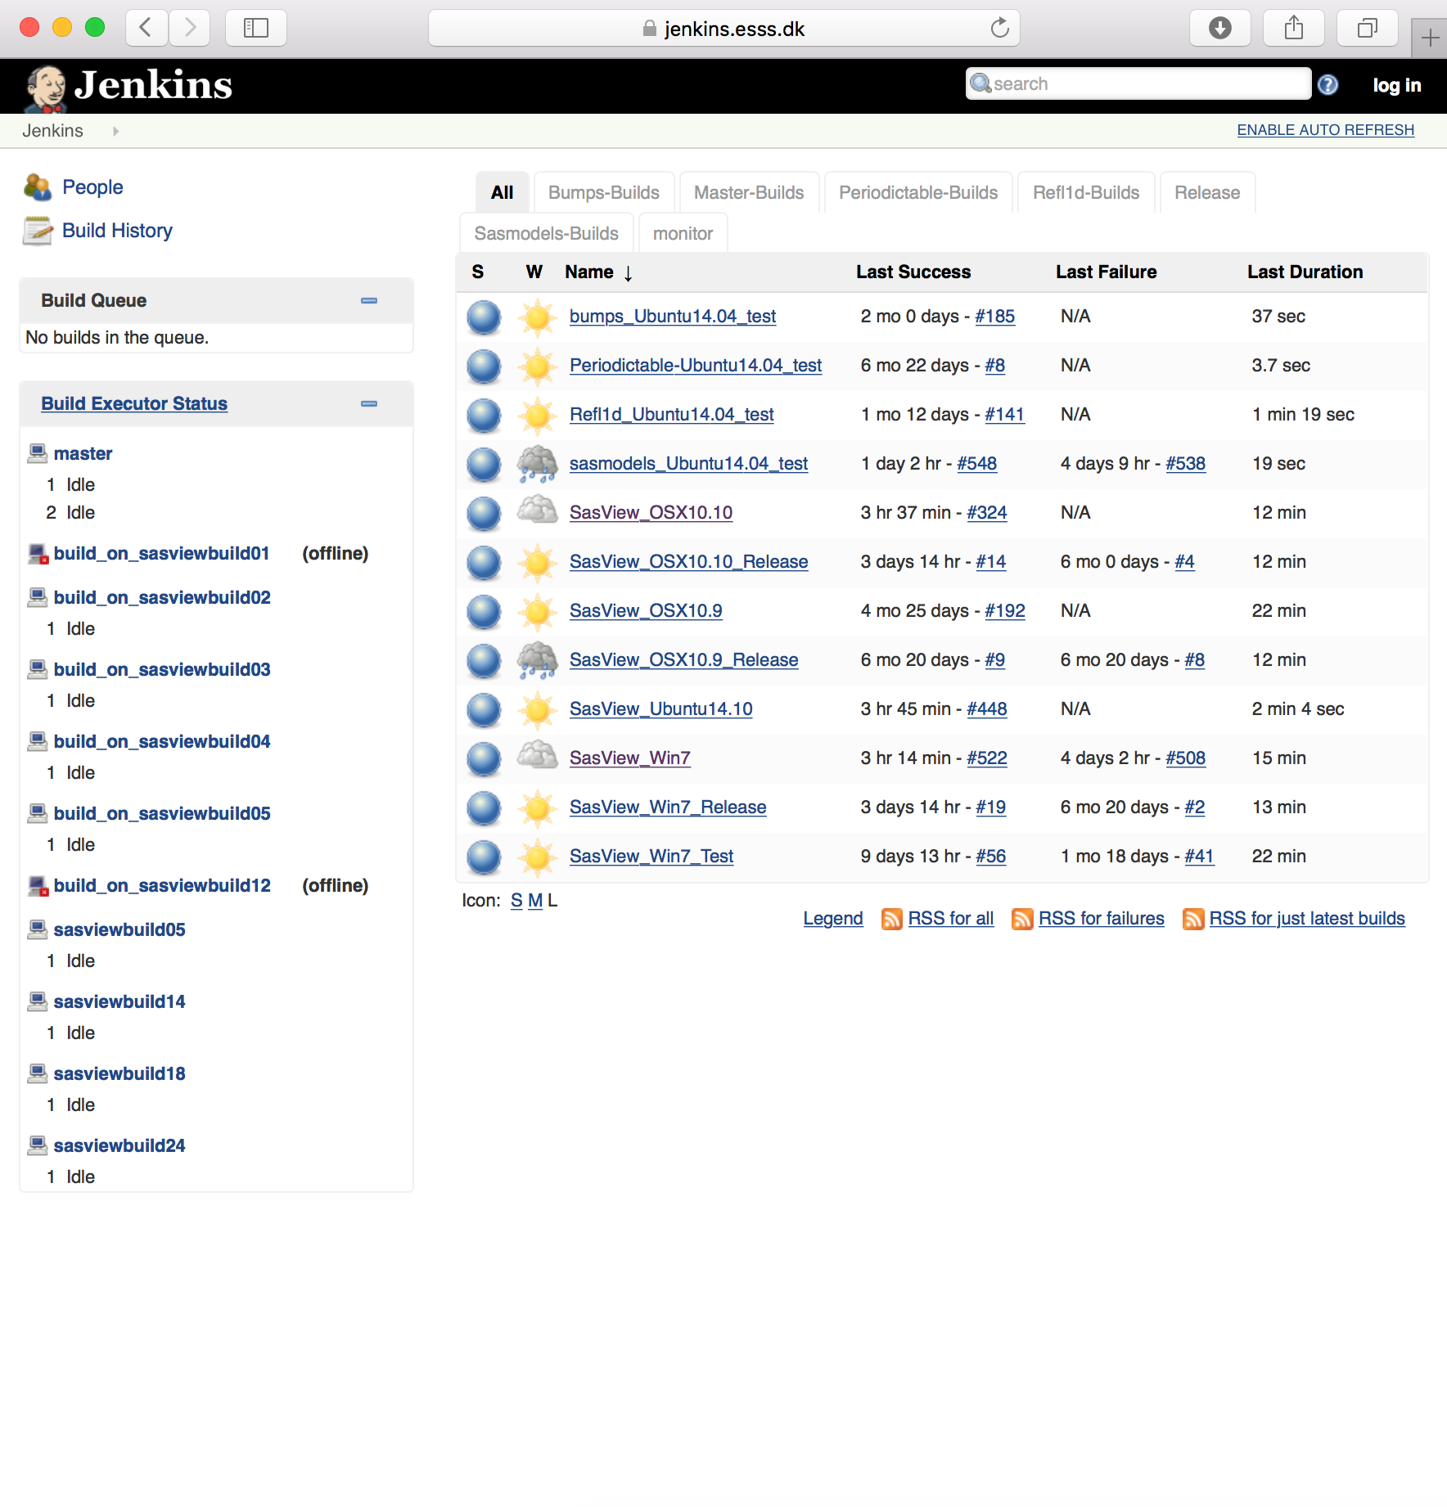
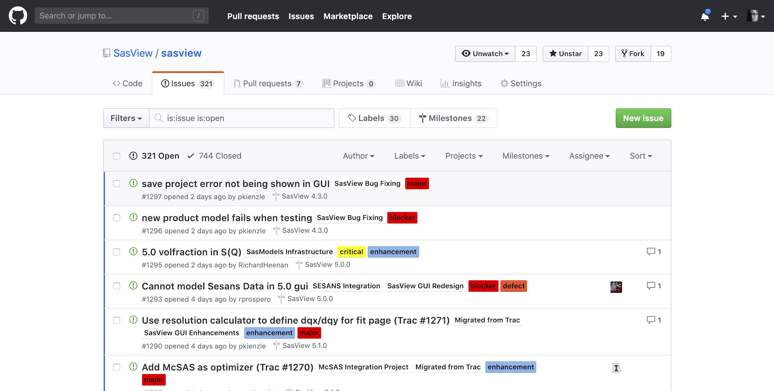
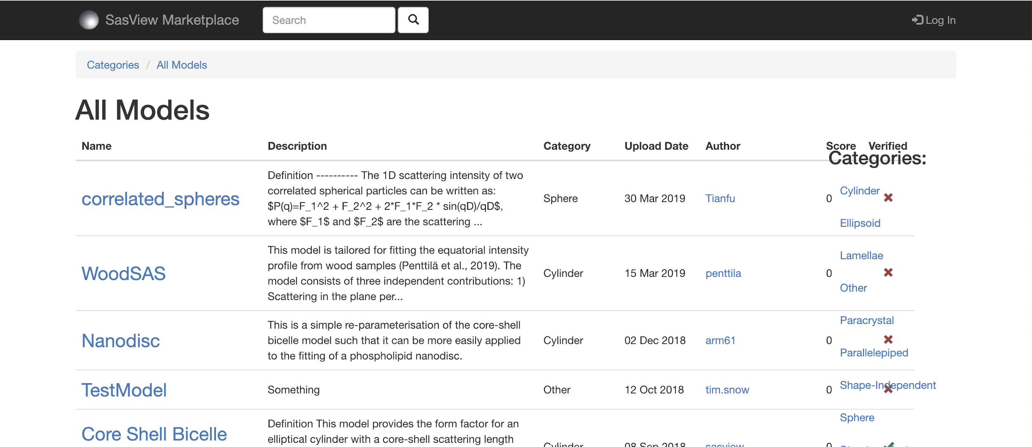
How We Work
Open, Collaborative, Community Development
Code is open source and publicly hosted at Github
Released under BSD 3-clause license
Bug and Enhancement Ticket System
Bi-weekly developer calls
Code Camps
5 Year Roadmap
Model Marketplace
DOI for each release
Code Hosting, Task and bug tracking, and developer/user wiki
Github
Model Marketplace for users to share their models
marketplace.sasview.org
Automated Builds
build.sasview.org
http://www.sasview.org
http://github.com/SasView

Slide 13
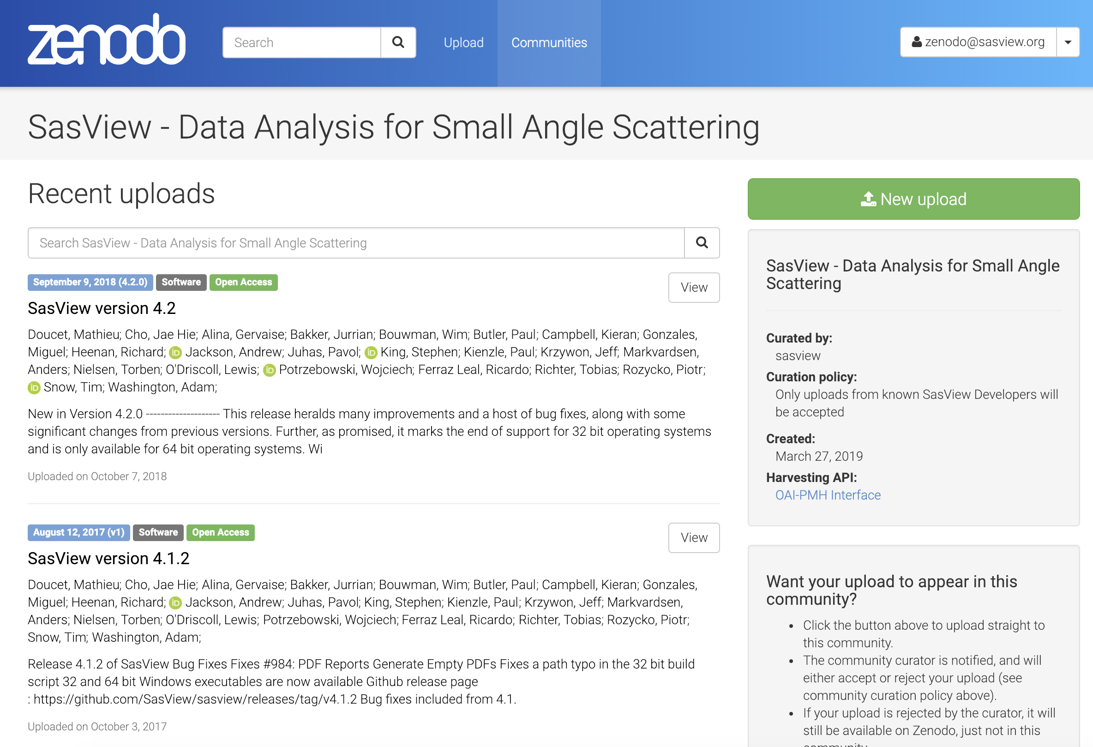
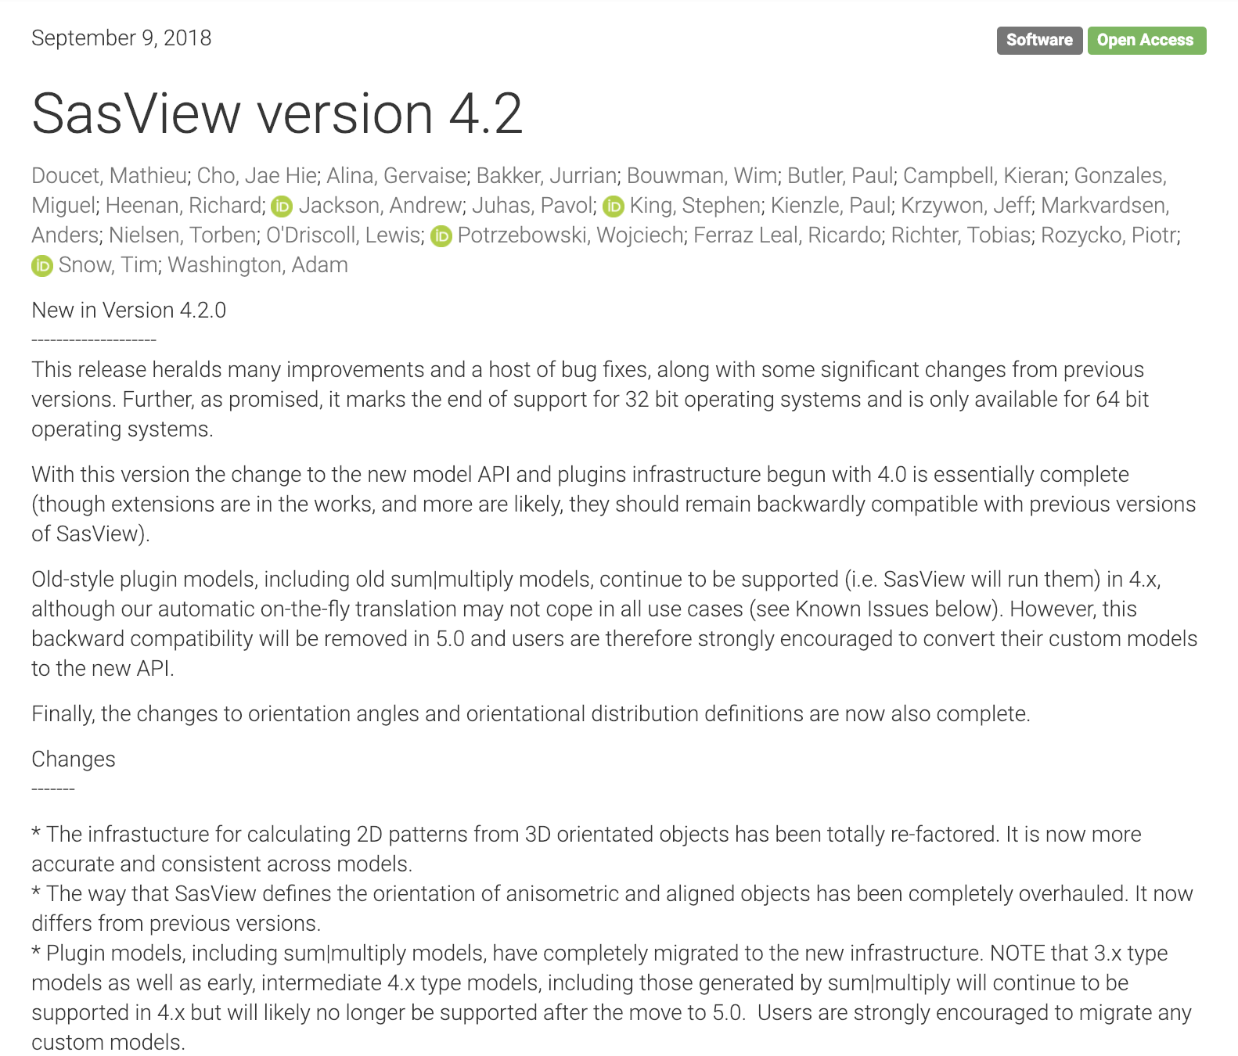
How We Work
Open, Collaborative, Community Development
DOI for each release
https://zenodo.org/communities/sasview-analysis
http://www.sasview.org
http://github.com/SasView

Slide 14
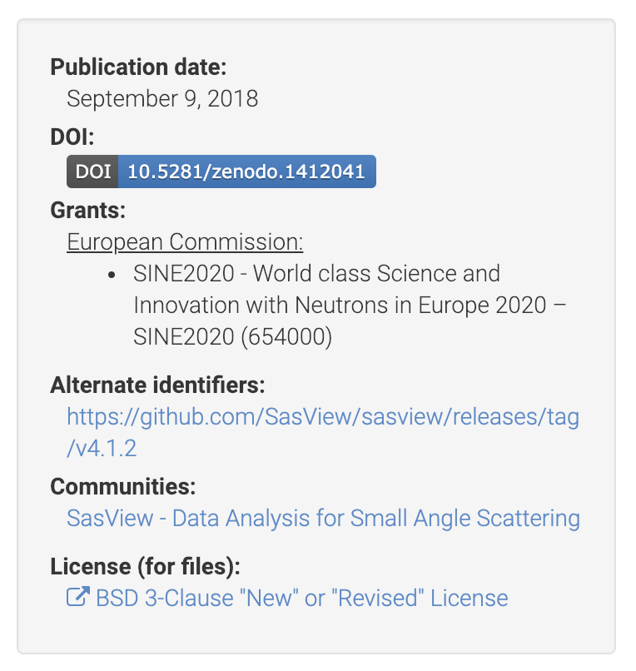
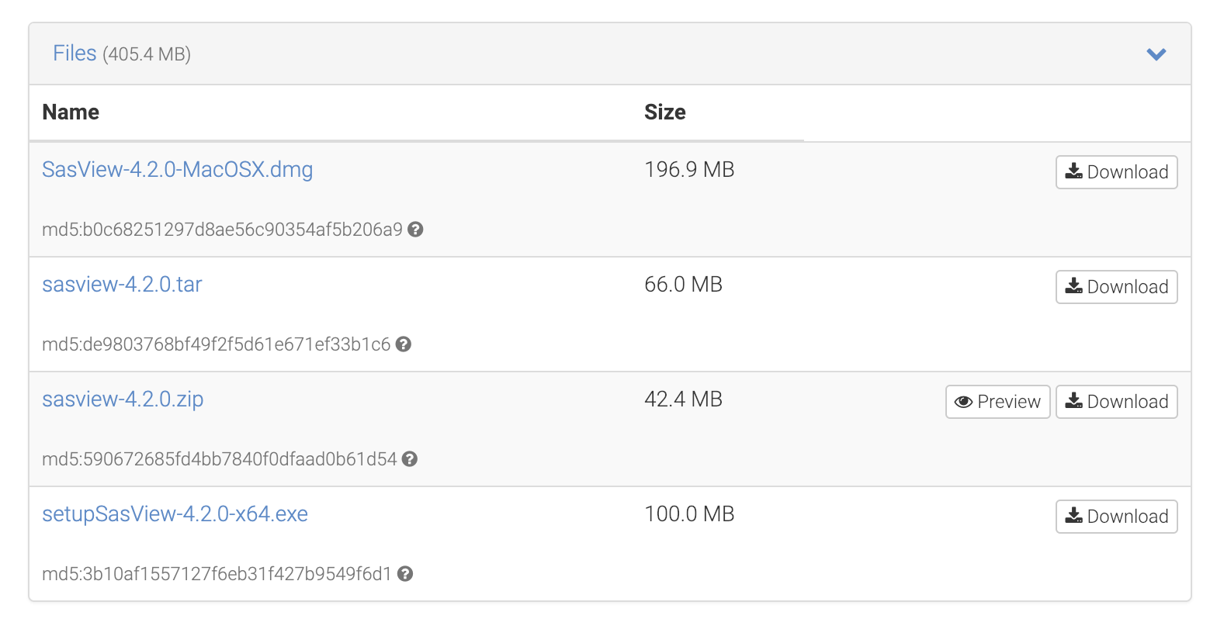
How We Work
Open, Collaborative, Community Development
DOI for each release
https://zenodo.org/communities/sasview-analysis
http://www.sasview.org
http://github.com/SasView

Slide 15
How We Work
Open, Collaborative, Community Development
We work together towards common goals formulated through community input, with two guiding principles ...
He who pays the piper …
Those who bring the resources (time and effort, or funds to buy time and effort) choose what to work on.
You break it, you bought it ...
You are not allowed to break what is already there for others. If you break it, you fix it.
http://www.sasview.org
http://github.com/SasView

Slide 16
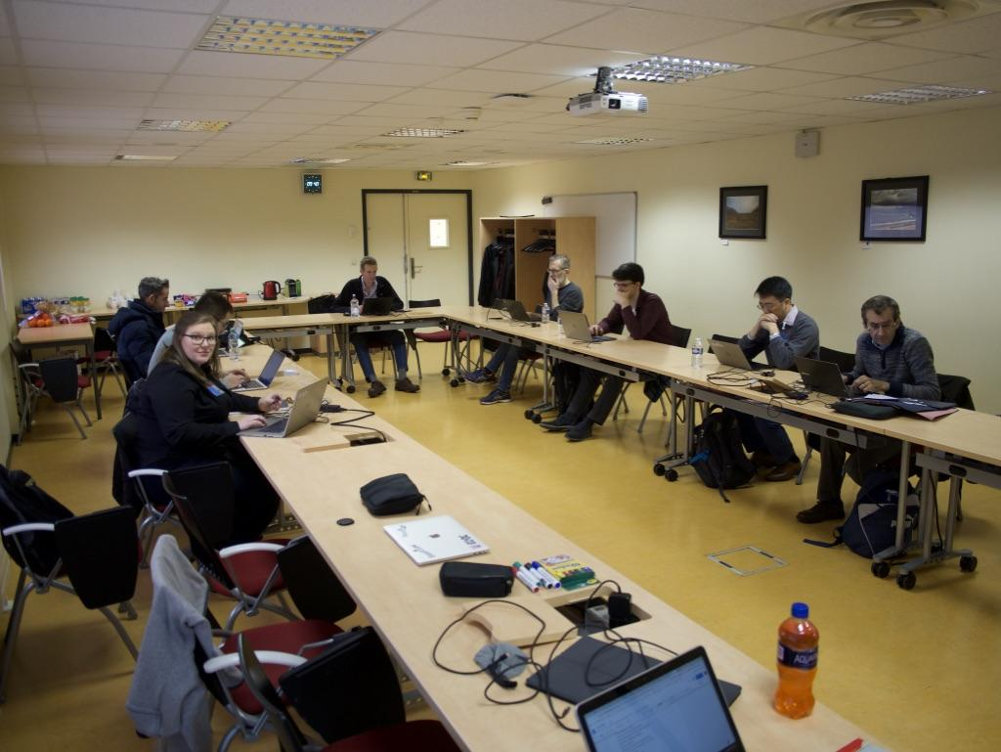
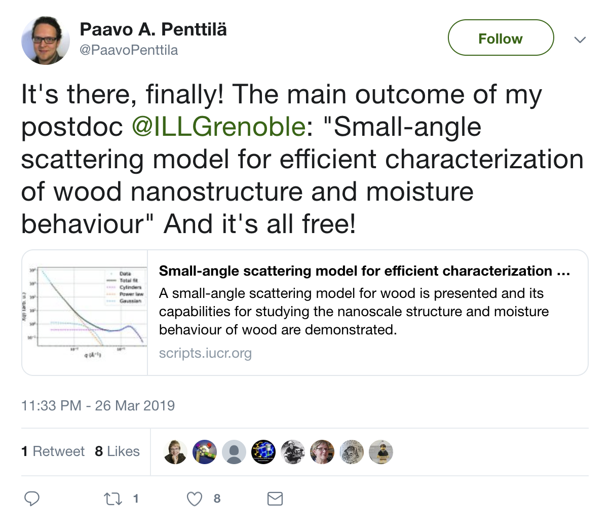
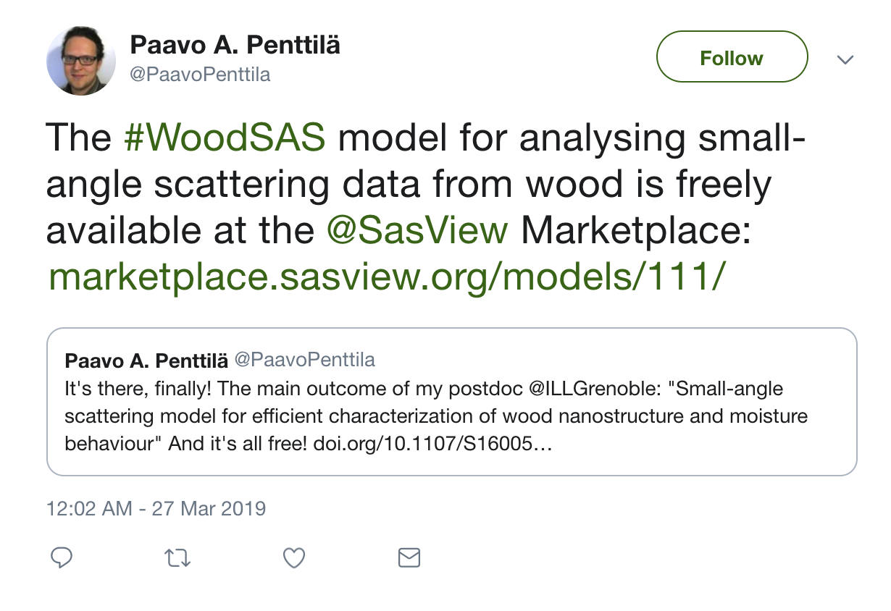
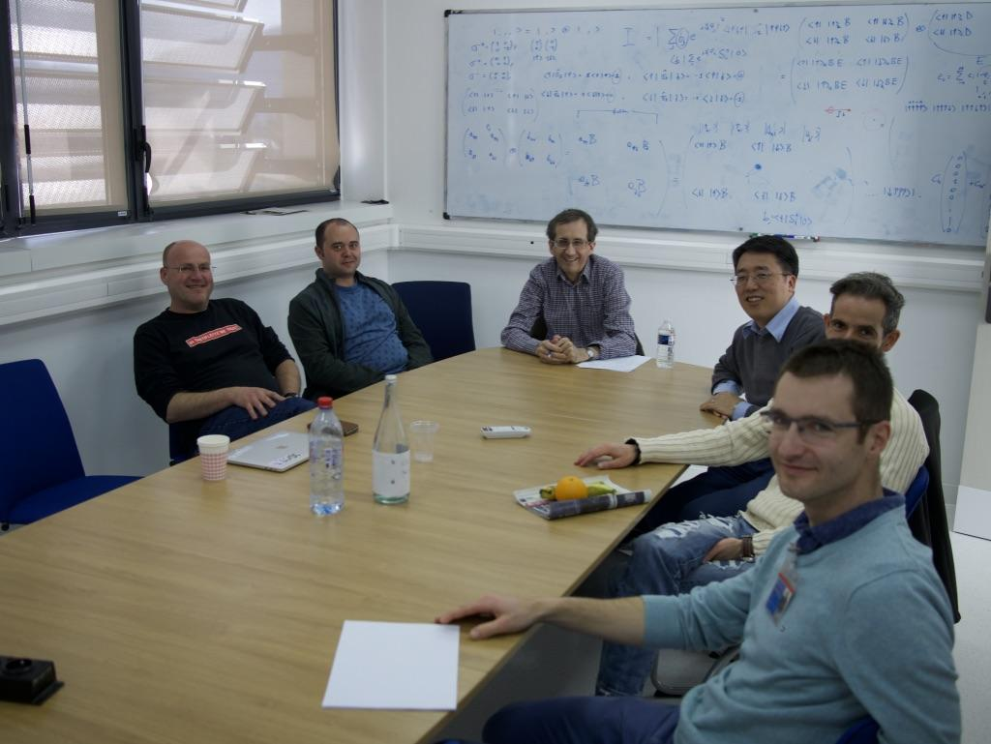
How We Work
Open, Collaborative, Community Development
Ask not what the community is going to do for you,
ask what you can do for the community
P. Butler, March 2019
http://www.sasview.org
http://github.com/SasView

Slide 17
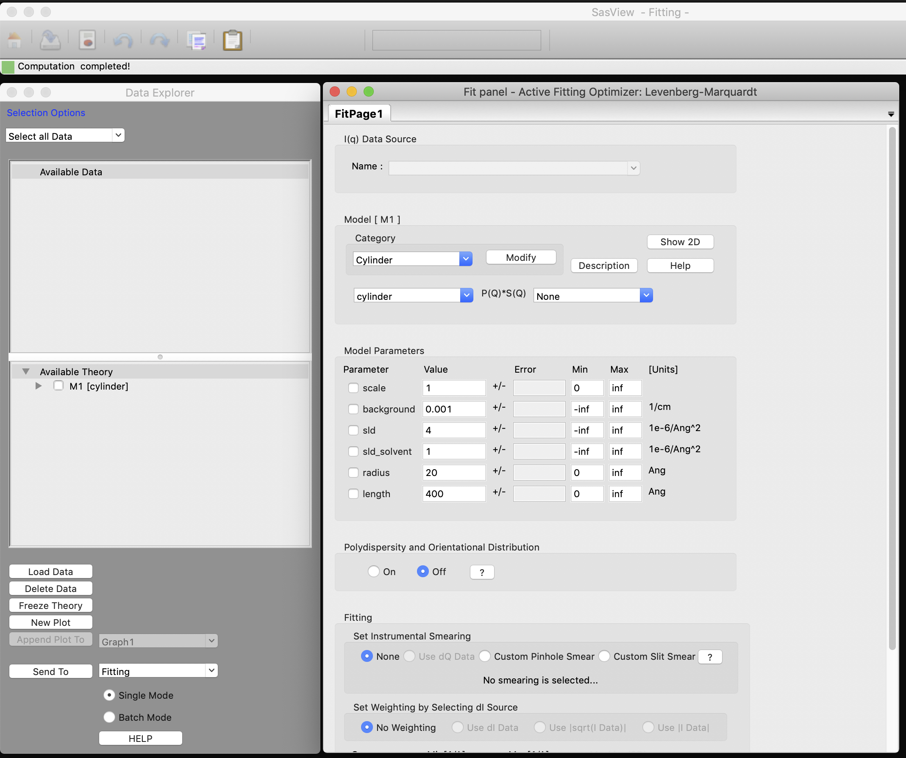
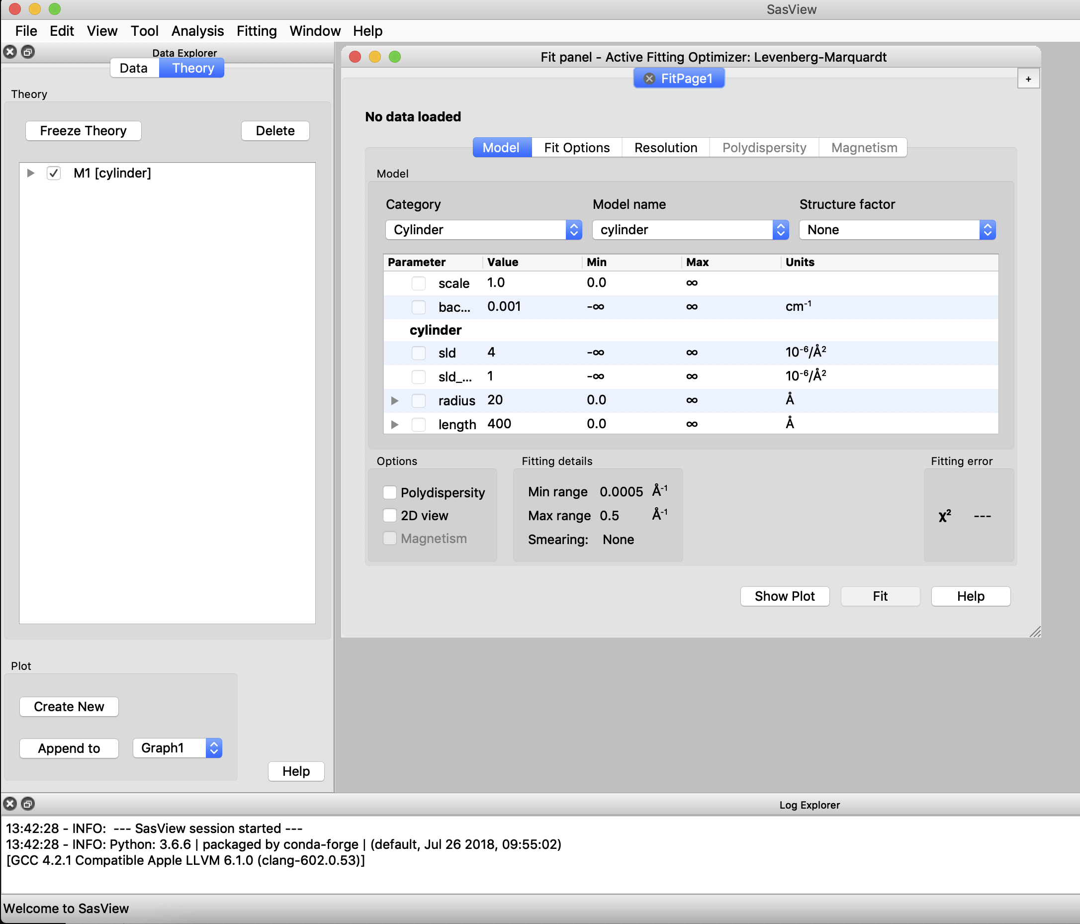
SINE 2020 Work - GUI
wxPython
Computation and GUI code mixed
“Organically developed” - hard for new developers
PyQT
Computation, GUI code, and models separated
Structured and documented - easier for new developers

Slide 18
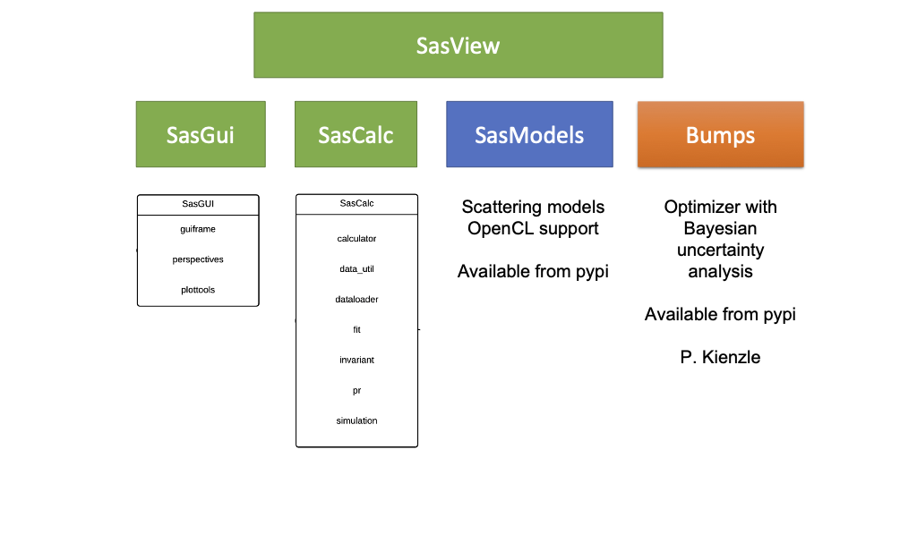
SINE 2020 Work - Code Separation

Slide 19
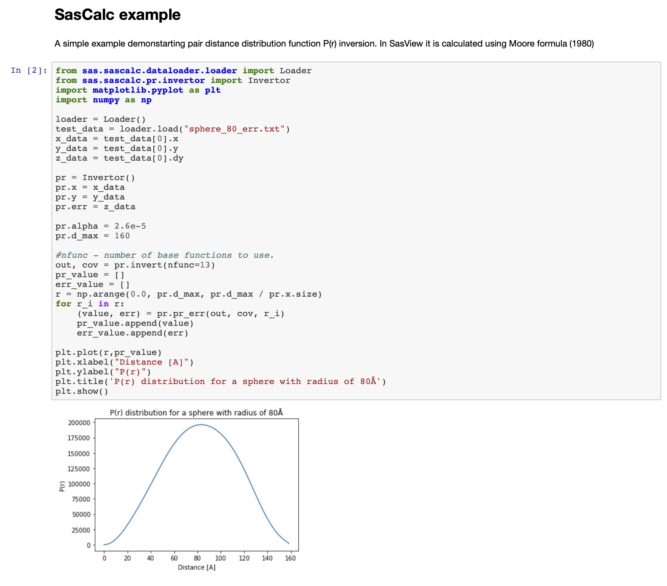
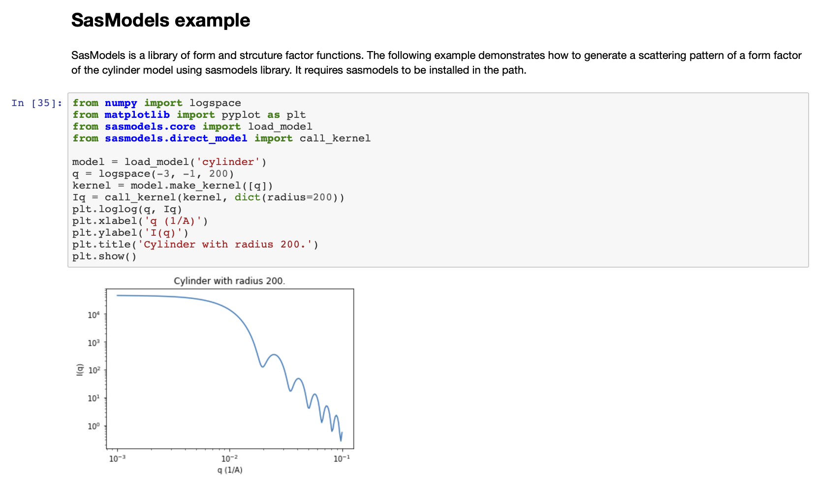
Jupyter Notebooks

Slide 20
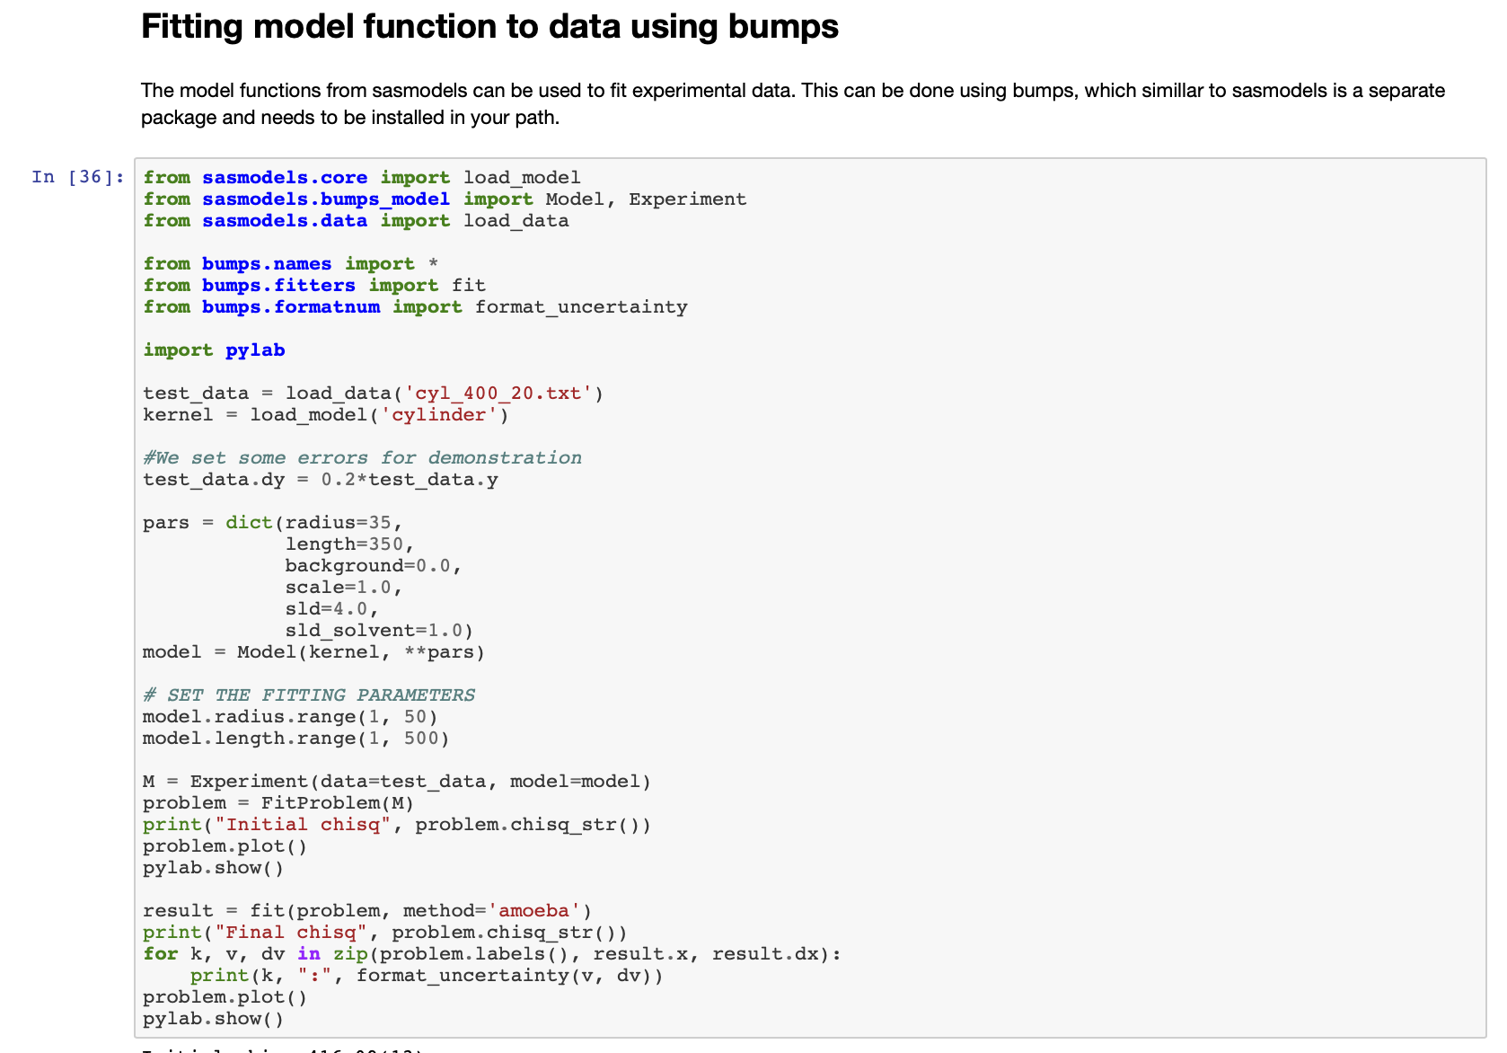
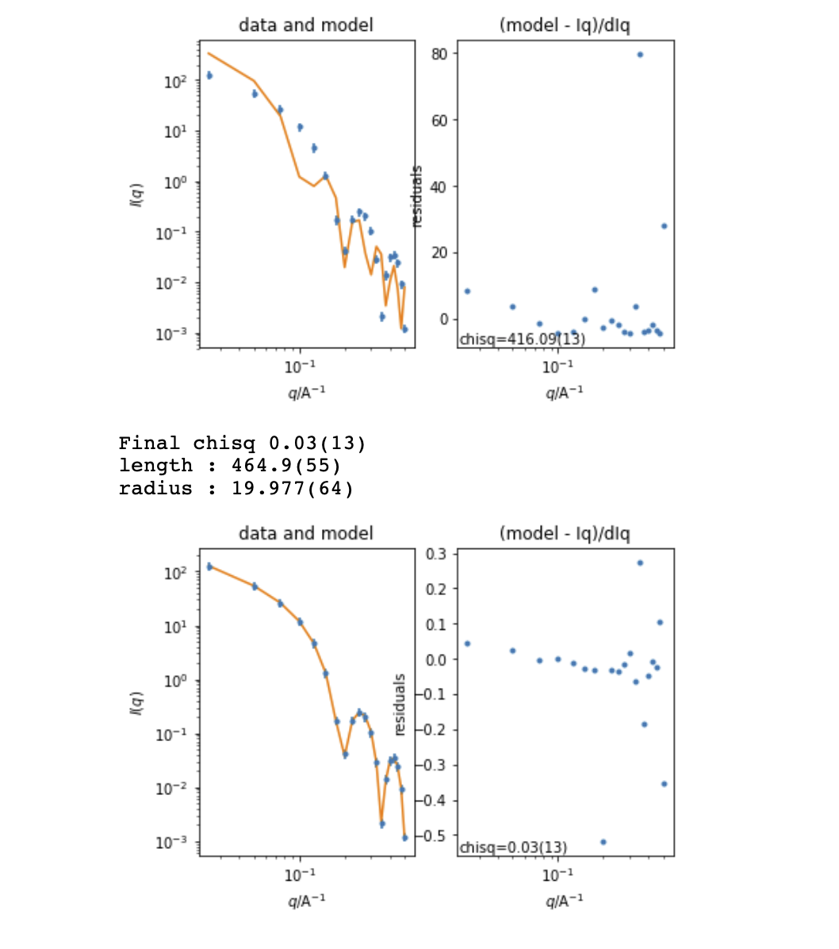
Jupyter Notebooks

Slide 21
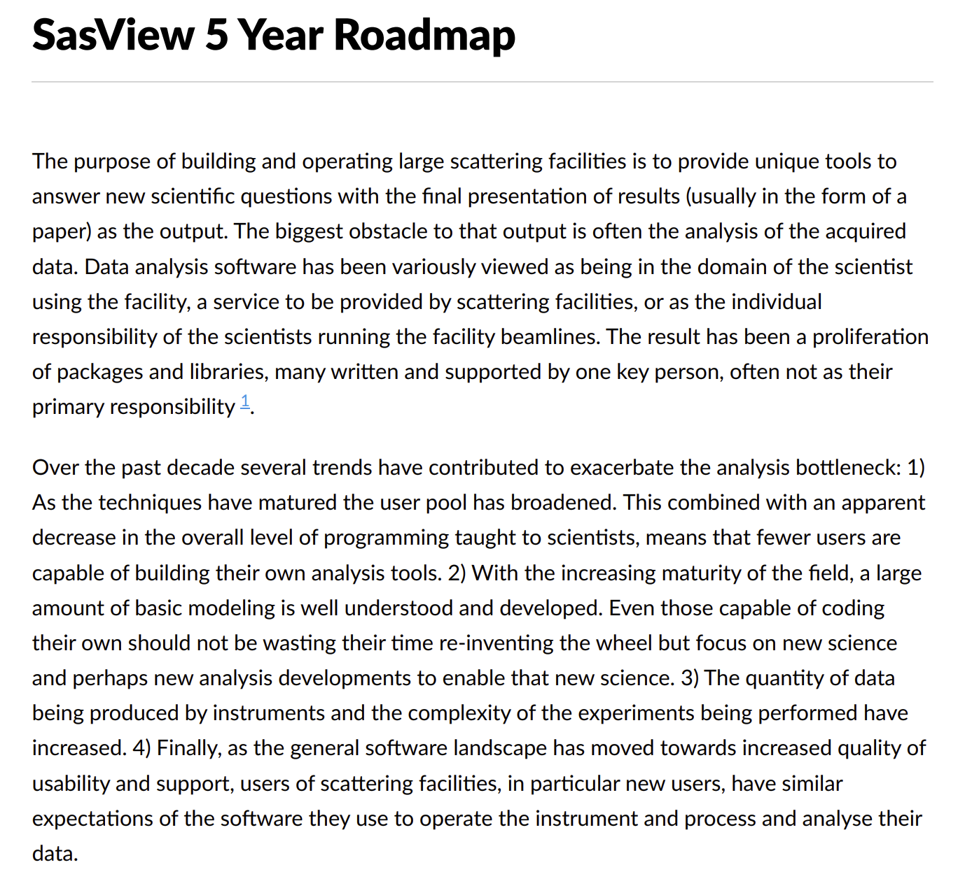
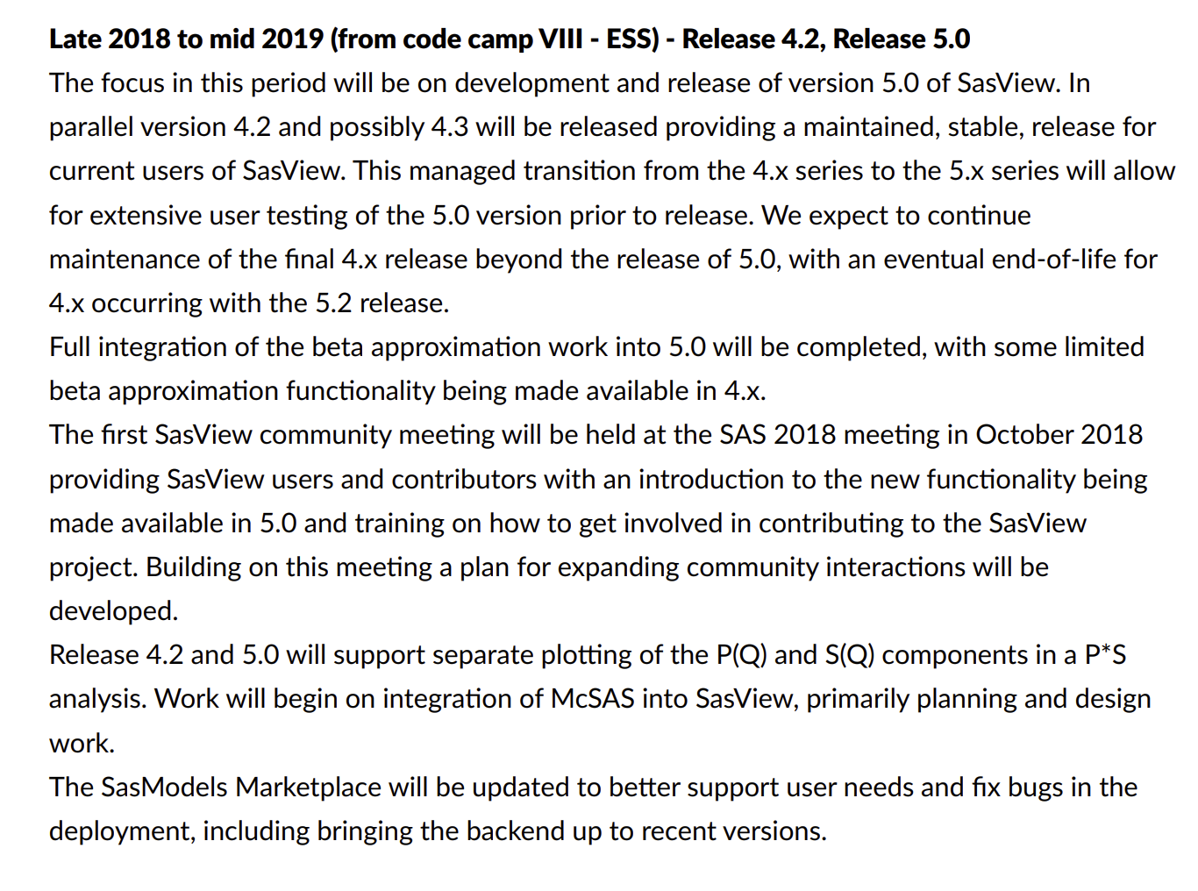
The RoadMap
Living document
Directs work for developers and helps find candidate projects for funding.
Discussed and updated at each Code Camp.
https://github.com/SasView/documents

Slide 22
Roadmap Late 2018 to mid 2019
Move focus of all GUI efforts to the new Qt GUI Done. Major bug fixes only to 4.x GUI
Parallel development and release tracks (5.x + 4.x) Working, but needs streamlining from 5.0 release
Complete beta approximation work In testing
New, more flexible interaction volumes/radii Underway?
Community meeting at SAS 2018 Done
Complete SasView paper Started
Consolidate and extend training material - both written tutorials and hands-on training material. Ongoing
Update model marketplace Needs developer
Create plan for developing community interactions. Started
Fixes to custom model editor to support polydispersity Done
Incorporation of models from:
SASFit^7 Work done, but not shipping by default. https://github.com/SasView/sasfit-models
Scatter^8 (Förster - crystalline materials models primarily) In discussions with BornAgain team
Project infrastructure cleanup:
ticket review/cull given 5.0 release Ongoing
possible move to GitHub issues. Underway
Release
5.0 alpha (late 2018) Done
5.0 beta (early 2019) Done
5.0 (mid 2019) On track
4.2 Done
Not in roadmap for this period …
Complete separation of sascalc package / headless usage
https://github.com/SasView/documents

Slide 23
SasView 4.x series - 4.2.1 current
www.sasview.org
Official Releases available for Windows, Mac, and Debian Linux
Models
New models
New model package (sasmodels)
Separation of models from GUI
Simpler addition of models by users
Speed! GPU and parallel processing
New, consistent approach to orientation distributions for 2D
Correlation Function Analysis
CCP13 corfunc algorithm
Documentation
Enhanced, updated documentation for models.
New Tutorials.
SESANS
Automatic transform of SANS model to P(z)
Plotting and fitting of SESANS data from GUI
Example scripts for fitting SESANS data
Simultaneous fitting of SANS & SESANS
Notes:
4.2 key points:
Orientation distributions
Bug fixes for plugin models
Many other bug fixes – see release notes!

Slide 24
SasView – the Next Generation – 5.x
Parallel release of 4.x and 5.x until 5 series is stable.
5.0 beta2 release out now for testing!
UI Refactoring (“SasView 5.0”)
Move to QT - current and well supported toolkit
Complete separation of GUI and calculation code
Provision of CLI & updated Python API
Release 5.0
Sasmodels Enhancements
Return F(q) from models
Beta approximation
Coherent sums
Constraints refactor
Multi-GPU support
Inclusion of SasFit models
Target release - 5.0
Target release - 5.1
Target release - 5.0
Integration of McSAS
Implementation of key models from Scatter
Target release - 5.1
Documentation
Tutorials – written, interactive & video
Manual

Slide 25
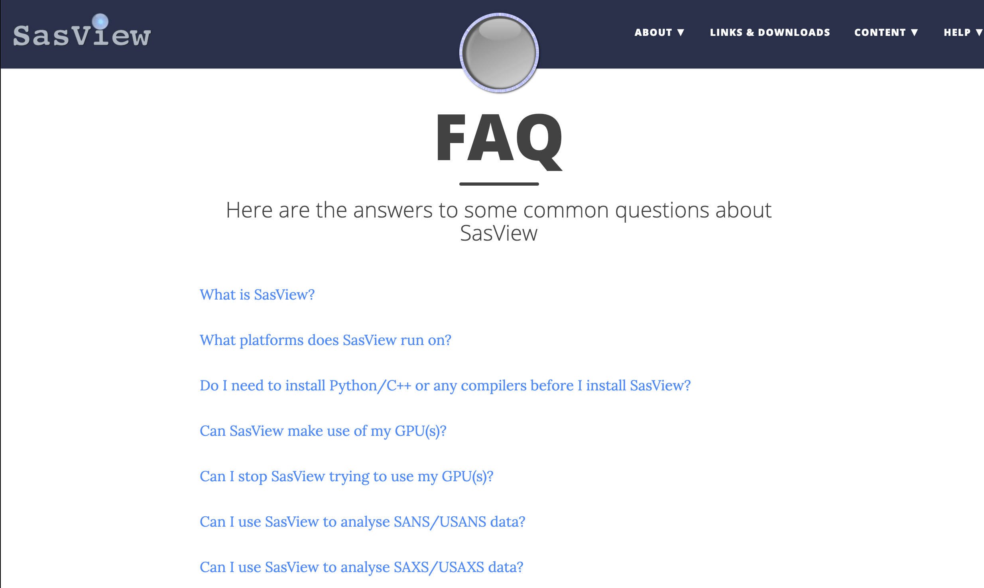
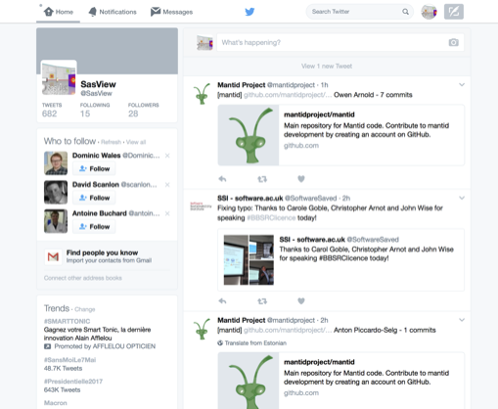
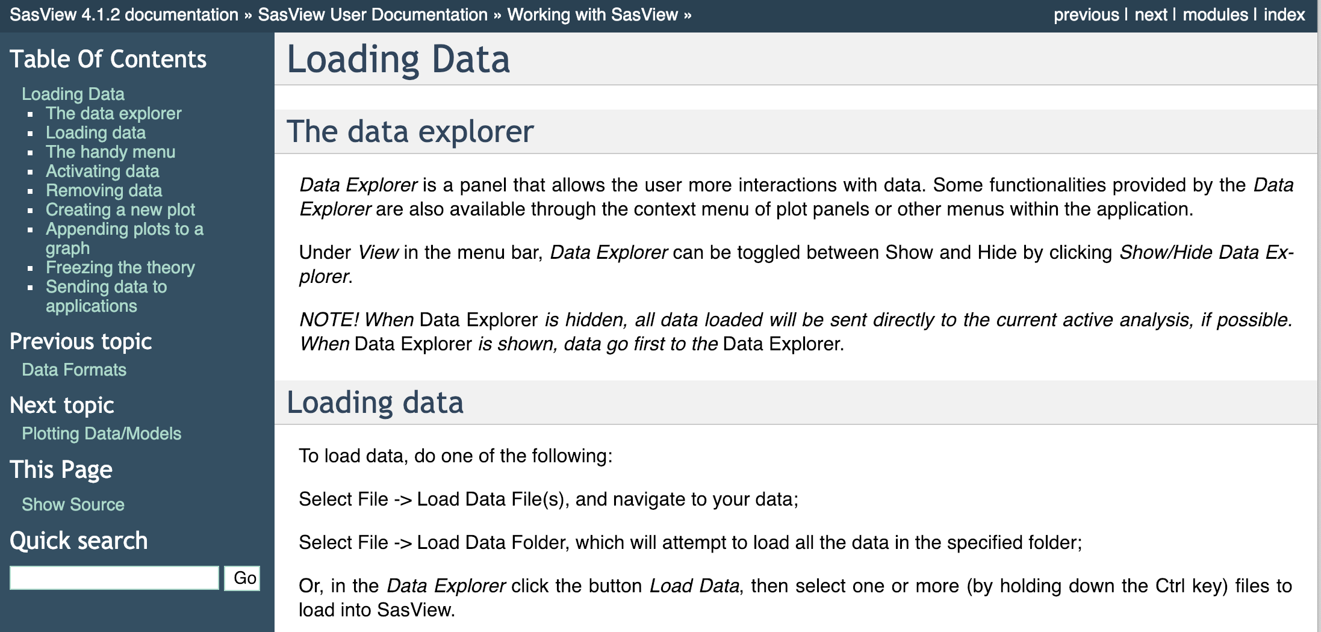
Education & Outreach
Website
Documentation
Written Tutorials
Video Tutorials (YouTube)
Taught courses
Scattering schools
University courses
E-learning
Bootcamps & Regional Workshops
Twitter
Slack
(Marketplace)

Slide 26
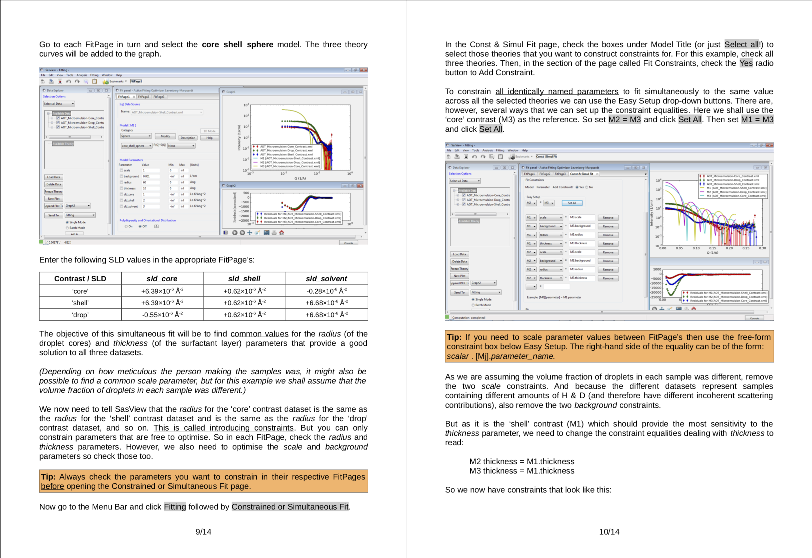
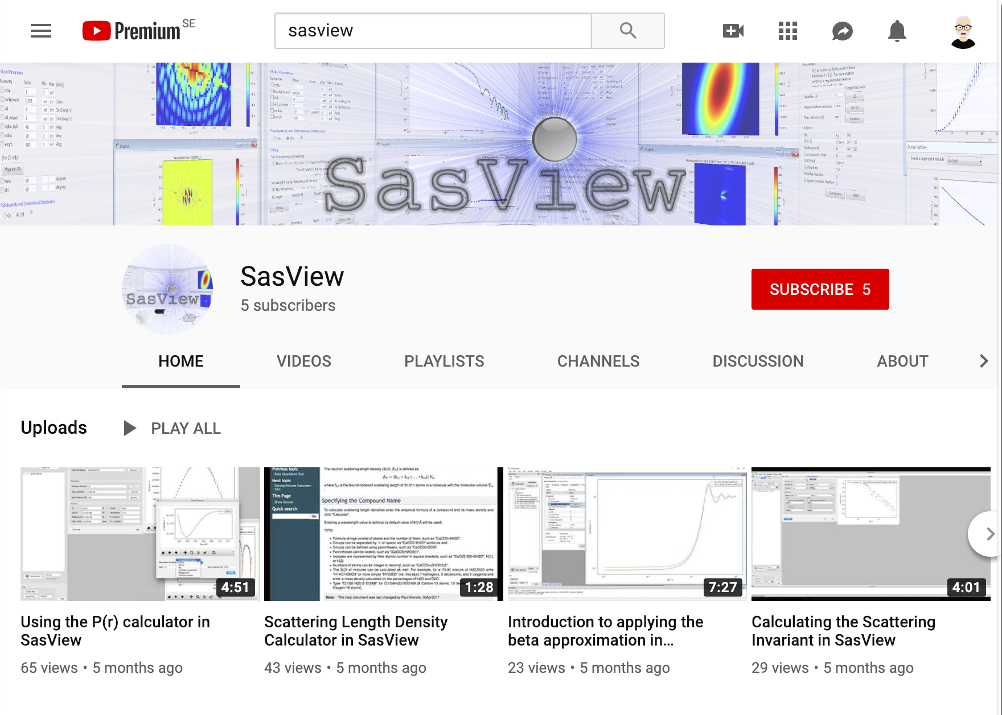
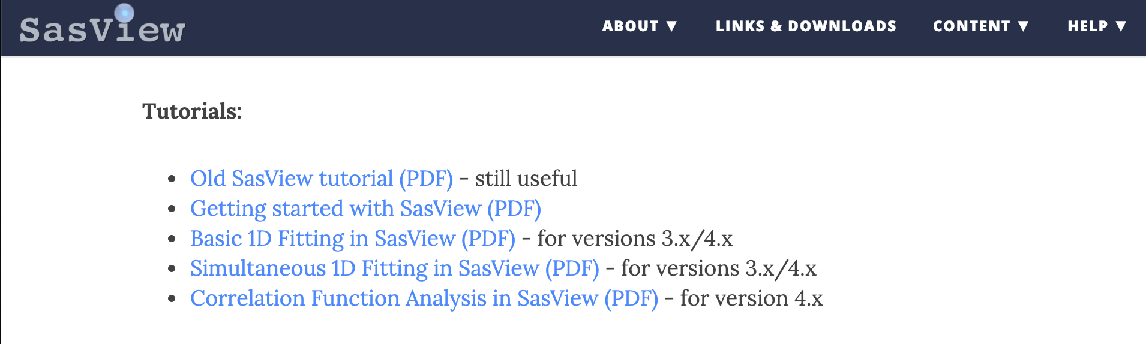
Education & Outreach
Website
Documentation
Written Tutorials
Video Tutorials (YouTube)
Taught courses
Scattering schools
University courses
E-learning
Bootcamps & Regional Workshops
Twitter
Slack
(Marketplace)

Slide 27
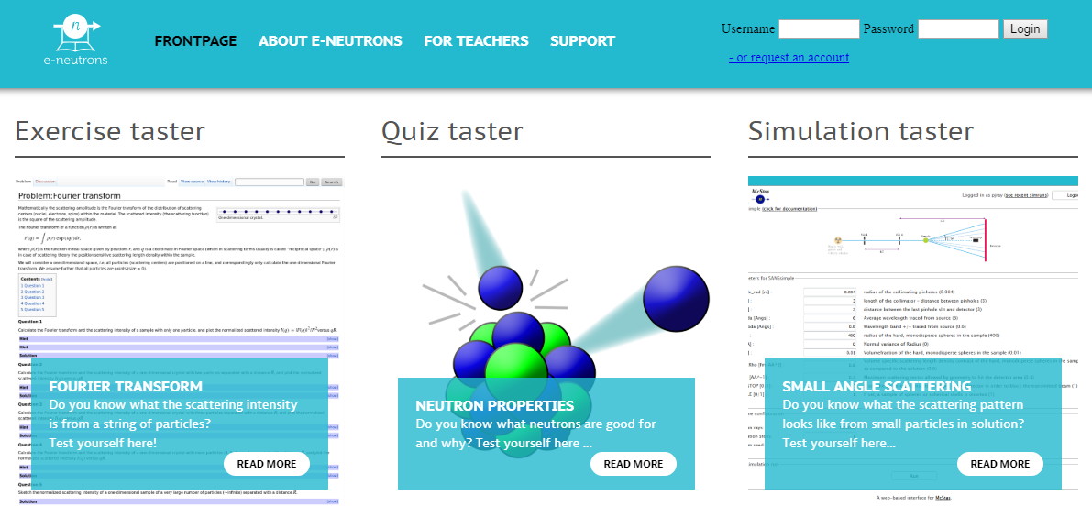

Education & Outreach
Website
Documentation
Written Tutorials
Video Tutorials (YouTube)
Taught courses
Scattering schools
University courses
E-learning
Bootcamps & Regional Workshops
Twitter
Slack
(Marketplace)
All the work of ISIS Sandwich Student Michael Oakley

Slide 28

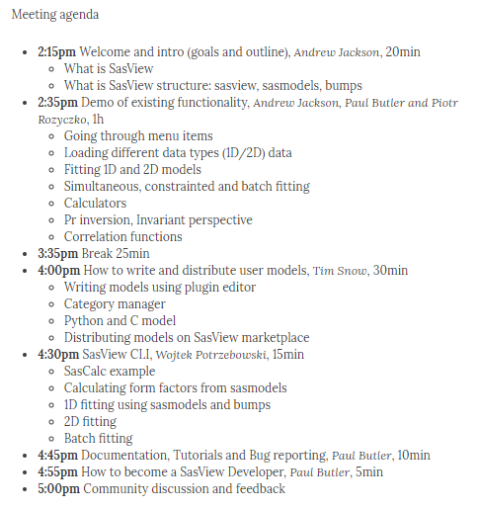

Education & Outreach
Website
Documentation
Written Tutorials
Video Tutorials (YouTube)
Taught courses
Scattering schools
University courses
E-learning
Bootcamps & Regional Workshops
Twitter
Slack
(Marketplace)

Slide 29

Education & Outreach
Website
Documentation
Written Tutorials
Video Tutorials (YouTube)
Taught courses
Scattering schools
University courses
E-learning
Bootcamps & Regional Workshops
Twitter
Slack
(Marketplace)
All the work of ISIS Summer Student Lewis O’Driscoll
Uses mySQL & Postgress
8 models contributed by 7 authors in 2 years

Slide 30




Come and Join the Fun!
Things people are saying about SansView/SasView
‘SansView is a very helpful tool, very complete and easy to use’ - Niki
‘I want to thank you for this amazing software. It’s UI and options make the interpretation of spectra easier and faster’ - Philippe
‘I really like the SasView software’ - Martin
‘I have been using SasView as my software of choice for fitting SANS data, and I have been very happy with the software’ - Greg
‘I have found SasView very easy to use and the batch fit function is a wonderful time saving tool. I can finally stop making painful excel macros!’ - Andrew
‘I am a new user of SasView and I think it is a very useful and practical tool’ - Arnaud
‘Within 30 seconds…I am completely converted to SasView!’ - Mike
‘Thank you for creating and maintaining SasView. It is an incredibly helpful tool, and I use it regularly’ - Pasha
‘All the best and thank you again to carry on such a good job on SasView’ - Niki
‘Ooooh NICE PROGRAMME!! Hours of fun!’ - Stuart
‘I love such amazing software so much. It help our researches a lot.’ - Po-Wei

